Slide 1

Doctorate Dissertation
진화하는 뉴럴 네트워크를 위한
확장형 부동소수점 컨볼루션 가속기
Scalable Floating-Point Convolution Accelerator
for Evolving Neural Networks
Examined By | Prof. KeonMyung Lee
 | Prof. SeokCheol Kee
 | Prof. DonKyu Baek
 | Prof. Yuseok Ban
Supervised By | Prof. HyungWon Kim
Presented By | Junaid Muhammad
2024. 06. 19
Dept. of Electronics Engineering, Chungbuk National University, Cheongju, South Korea.

Slide 2
Outline
1
5
Publications
6
Introduction and Related Work
Questions and Answers
2
Floating Point Optimization for CNN Training Accelerator
3
Floating Point Optimization for CNN Inference Accelerator
Conclusion and Future Plan
4
DREAM: Dynamic (Mantissa) Reduction and Exponent Asymmetric Method _{(Chapter 3)}
GOALE: Genetic (Mantissa) Optimization and Asymmetric Layer-wise Exponent _{(Chapter 4)}

Slide 3
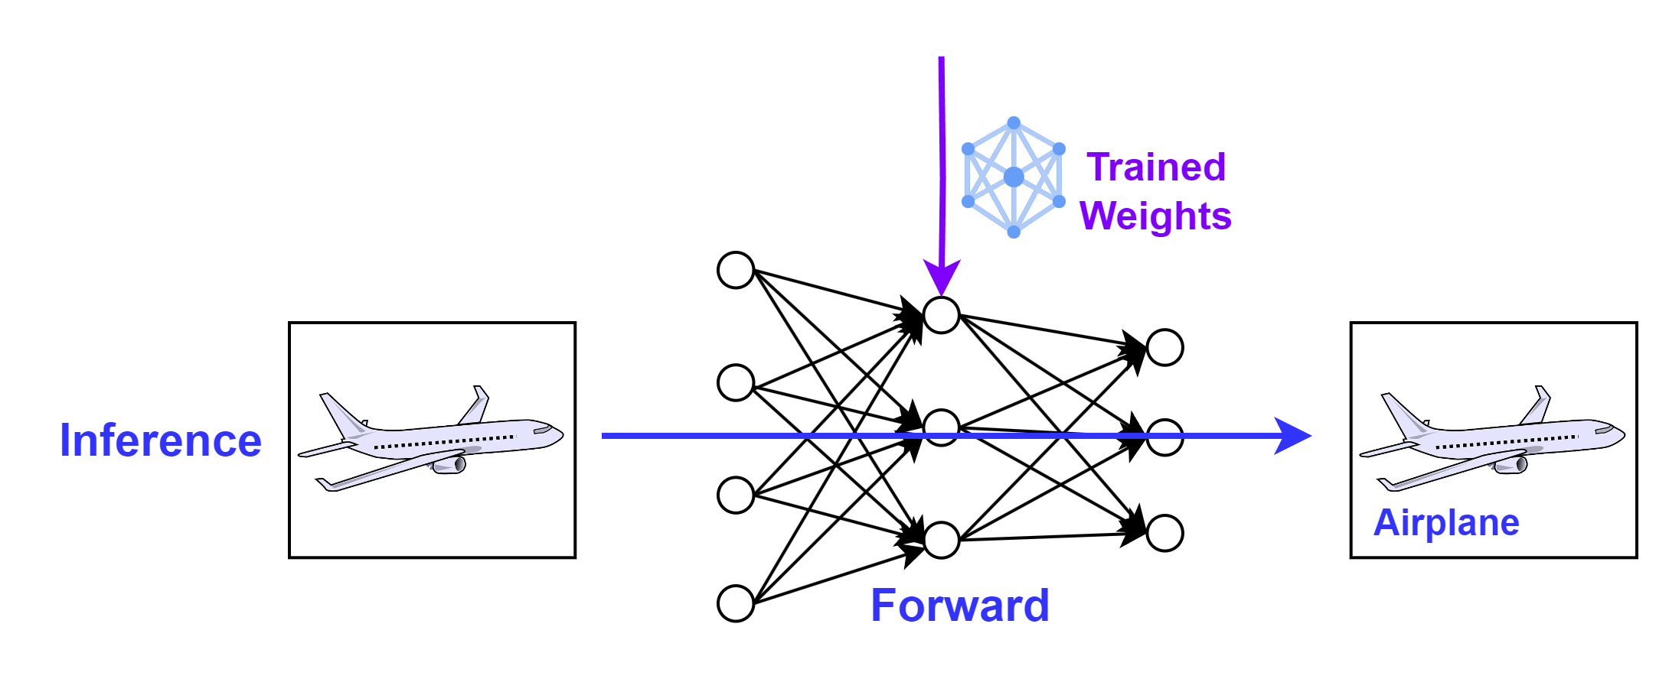
CNN Inference
Utilize the trained model to predict new/unseen data
Forward Propagation: Sequential processing of input data through network layers, resulting in final output.
Classification Tasks: Final Output is Class Label
Object Detection Tasks: Class Labels, Bounding Boxes and Confidence score
Post-Processing: Apply transformations to the raw output to make it interpretable

Slide 4
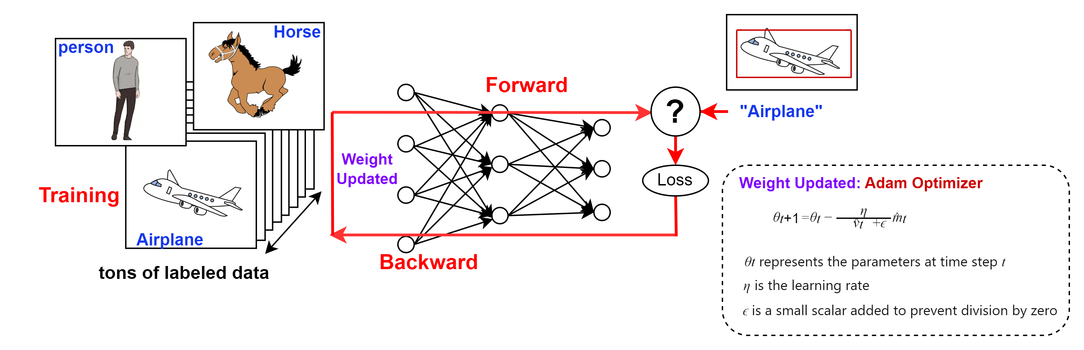
CNN Training
Enabling models to learn and make intelligent decisions.
Forward Propagation: Sequential processing of input data through network layers, resulting in final output.
Loss Calculation: Quantifies discrepancy between the network’s output and actual output using a loss function.
Backpropagation: Computes loss function gradient, using the chain rule to propagate this gradient backward through the network.
Weight Update: Applies optimization algorithms to adjust network weights, minimizing the loss.

Slide 5
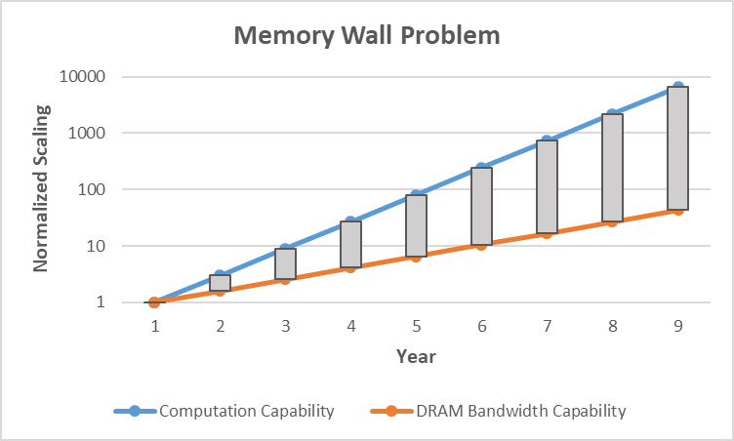
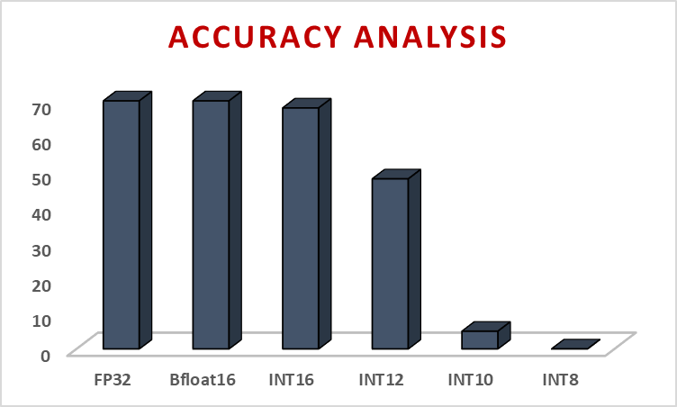
Problem Statement
Challenges of Deploying High-Accuracy CNNs on Resource-Constrained Edge AI Accelerators
Memory Wall Problem
The hardware computation capability is increasing at 3x every 2 year
Memory Bandwidth is increasing by 1.6x
→ Moving Data from memory to the accelerator is the bottleneck
Scaling Gap
Hardware Resources
Convolution Operators consume enormous power and area
Require low-power, compact, and high-speed edge devices.
Accuracy challenge
Traditional quantization methods affect the model’s accuracy.
Notes:
One of the Biggest Challenge in deploying CNNs on Edge Devices is the unequal scaling of hardware capabilities. With each passing year the computation time is reducing by a larger factor than reduction in the time required by memory. This makes the memory bandwidth bottleneck. The 2nd challenge is that convolutional operators in CNNs consumes enormous power and area. While we want our edge device to be low power and compact. One straightforward approach to address these issues is to reduce the data width of the model. Instead of using 32B bits we can use smaller datawidth. But this introduces significant accuracy drop.

Slide 6
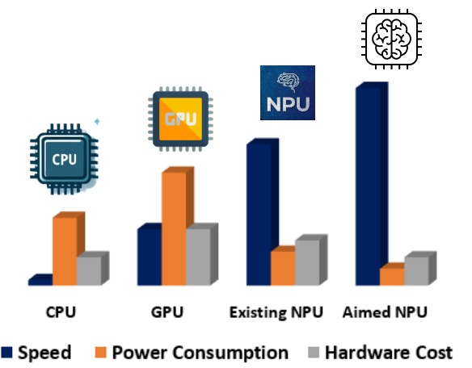
Introduction
Motivation
To address the bottleneck created by the memory wall problem:
Reducing Memory requirement
Optimizing Memory access
New Trend in CNN Edge Accelerators:
Low power
Low area
High-performance accelerators
Contributions
Optimized Arithmetic for:
CNN Training Accelerator
CNN Inference Accelerator
Optimized Memory Access
Minimized Memory Requirement
Faster CNN Accelerator
Notes:
To address these issues My research is focused on optimizing arithmetic and data paths. By targeting the arithmetic, I am focusing on optimizing more than 90% of the hardware in traditional CNNs, which have convolution layers and require arithmetic operators such as adders and multipliers.

Slide 7
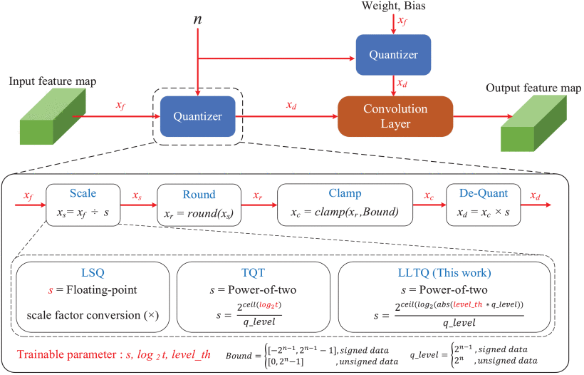
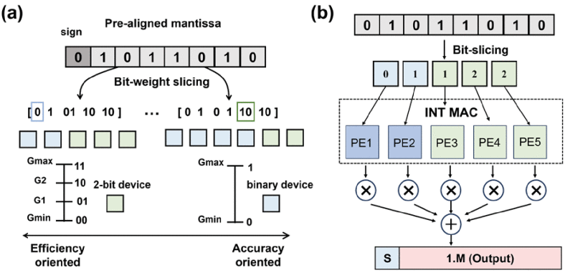
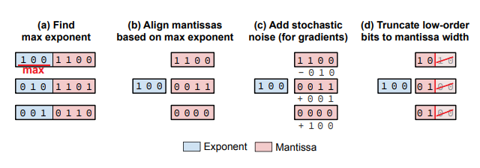
Related Work
Integer Arithmetic for CNN Accelerators
Not practical for Training Accelerators
Relatively low accuracy than floating point based inference
Brain Floating Point for Mantissa Optimization
No optimization on Exponent
Lack of mixed precision
The Block Floating Point (BFP) format for Exponent Optimization
Efficiency is highly dependent on the block size.
Small block size ➔ negligible benefits
8x8 block size for 416x416 image
: 0.03% common exponent
Large block size ➔ sacrificing smaller data values in the common block
Reduced overall accuracy.
[1] Kim, J. -K. Kang and Y. Kim, "A Resource Efficient Integer-Arithmetic-Only FPGA-Based CNN Accelerator for Real-Time Facial Emotion Recognition," in IEEE Access
[2] S. -Q. Tong et al., "Energy-Efficient Brain Floating Point Convolutional Neural Network Using Memristors," in IEEE Transactions on Electron Devices
[3] Noh, S.-H.; Koo, J.; Lee, S.; Park, J.; Kung, J. FlexBlock: A Flexible DNN Training Accelerator with Multi-Mode Block Floating Point Support. IEEE Trans. Computer. 2023, 72, 2522–2535
Notes:
To optimize the arithmetic, few researchers are working on integer arithmetic. But integer quantization methods have failed to provide reasonable results for training. Then few researchers have evaluated the brain floating point to optimize the mantissa width from default 23 bits to 7 bits. But bfloat doesn’t support optimization on exponent and no support for mixed precision. For exponent optimization, block fp is evaluated where a common exponent is sent for a block of numbers but the efficiency is highly dependent on the block size. Smaller block size have negligible benefits while a larger block size has reduced accuracy

Slide 8
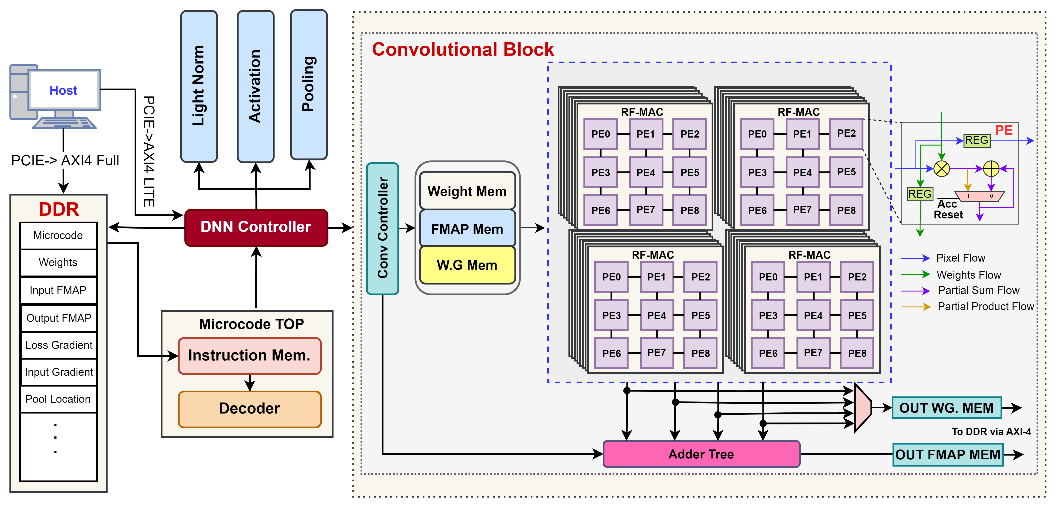
Floating Point Optimization for CNN Training Accelerator
Section 2: Thesis Chapter 3
DREAM: Dynamic (Mantissa) Reduction and Exponent Asymmetric Method
Notes:
To address these limitations we came up with our own optimization method DREAM.

Slide 9
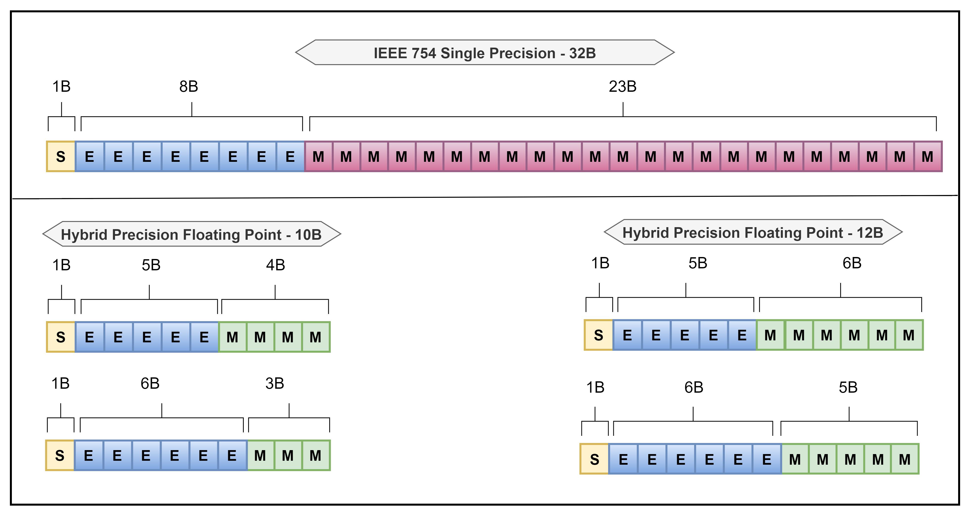
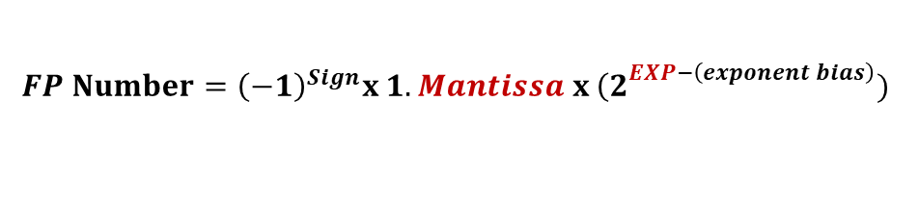
DREAM: Dynamic (Mantissa) Reduction and Exponent Asymmetric Method
Aims to provide better FP optimization method for Training Accelerators
$$FP Number={\left(−1\right)}^{Sign}x 1.Mantissa x {\left(2\right.}^{EXP−\left(exponent bias\right)})$$
Feature | Previous Works | DREAM
Hybrid Asymmetrical Exponent based on data type | No | Yes
Mantissa Optimization | Fixed | Dynamic
Data Path precision as compared to Arithmetic precision | Highest | Lowest
Rounding Methods | Near to Zero | Stochastic
Notes:
This equation represents a general floating point number, consisting of a sign, mantissa, and exponent. In all subsequent slides, whenever I mention "mantissa," I am referring to this fractional part, and when I mention "exponent," I am referring to the exponent without bias. This is based on the default IEEE FP32 format. My goal is to reduce data widths without significant loss of accuracy.
If we compare with Previous methods, they either use symmetrical or if they use asymmetrical exponents they use it uniformly for all layers. My method, however, determines the asymmetrical exponent range based on the data type, with separate ranges for images, weights, and gradients. While traditional mantissa optimization methods are fixed, DREAM employs dynamic optimization based on feedback. A key difference in my approach is that, unlike mixed precision models that support the highest precision layer in data path, I support the lowest precision layer, which enhances DRAM access and using Stochastic Rounding methods to compensate the accuracy drop.

Slide 10
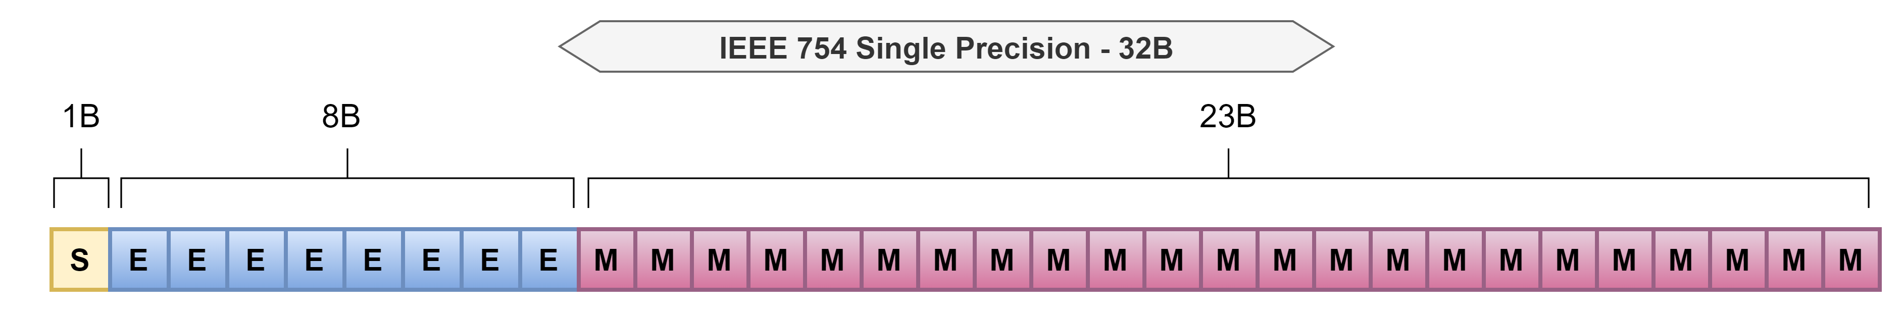
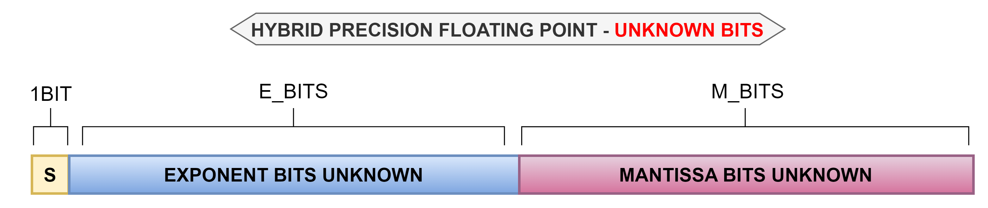
Step 1: Exponent Optimization
Notes:
The first step in optimizing the floating-point representation is to optimize the exponent. At this point, the optimal number of exponent bits and mantissa bits are both unknown.

Slide 11
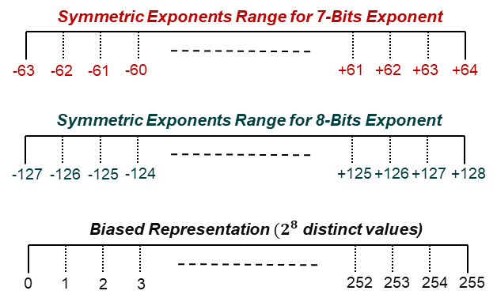
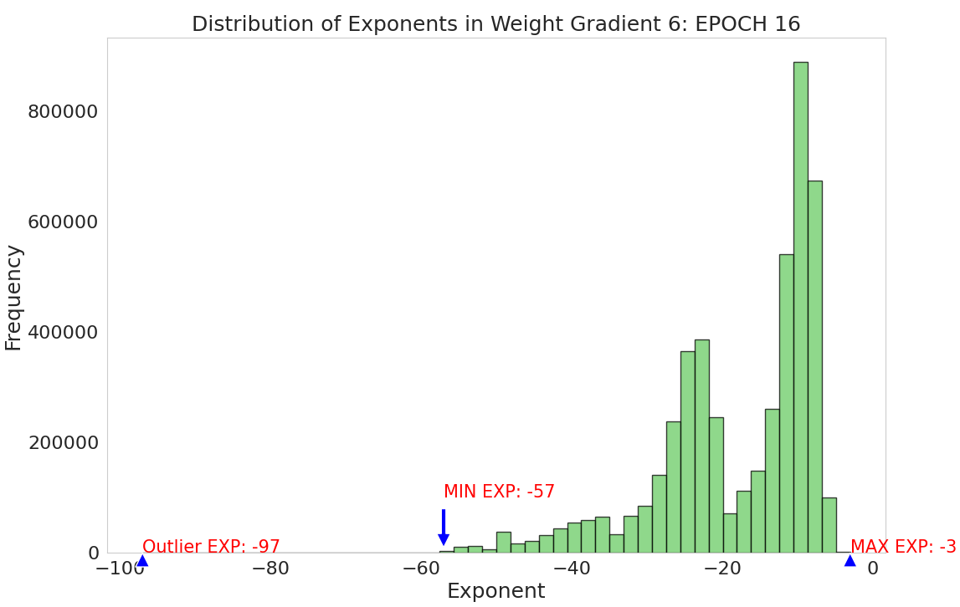
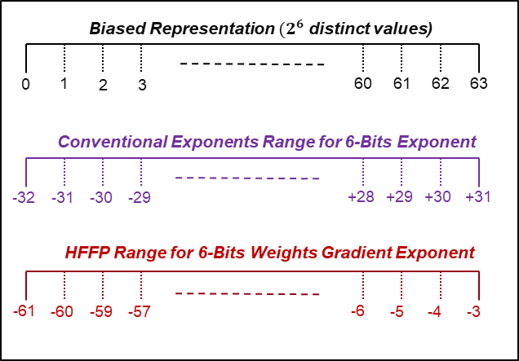
Asymmetric Exponent Optimization
Eliminate redundancy of Symmetry.
-97 to +4 → 102 distinct values
8-bits needed → 154 values wasted
Asymmetric Optimization based on data
Weights
Activations
Input Gradients, Weight Gradients
Evaluate the impact of removing outliers
Notes:
Exponent optimization can be done by eliminating the redundancy of symmetry and removing the outliers. For example, in this exponent distribution, the maximum exponent is -3, and the minimum is -97. If we represent this range using traditional mapping of 8 bits, more than 60% of available representations would be wasted. However, by properly managing the outliers and mapping only the important exponents, we can represent this distribution in 6 bits without losing much accuracy.

Slide 12
Asymmetric Exponent Optimization - Algorithm
Goal
To find the exponents mapping which utilizes the complete range exponent bits has to offer
Full Precision (Reference Model)
Notes:
The algorithm for Exponent Optimization begins by calculating the percentage of exponent occurrence in the model. Then, it finds the maximum and minimum exponents. If the minimum exponent occurrence is less than the outlier threshold, then algorithm will drop that exponent and will find the next minimum exponent. After that, it will determine the minimum number of bits needed to represent this range. It then calculates the mAP degradation. If the mAP degradation is higher than the allowed degradation, the algorithm will keep reduce the outlier threshold and find the exponent range again. In this way for every model it will determine what percentage of outliers can be dropped.

Slide 13
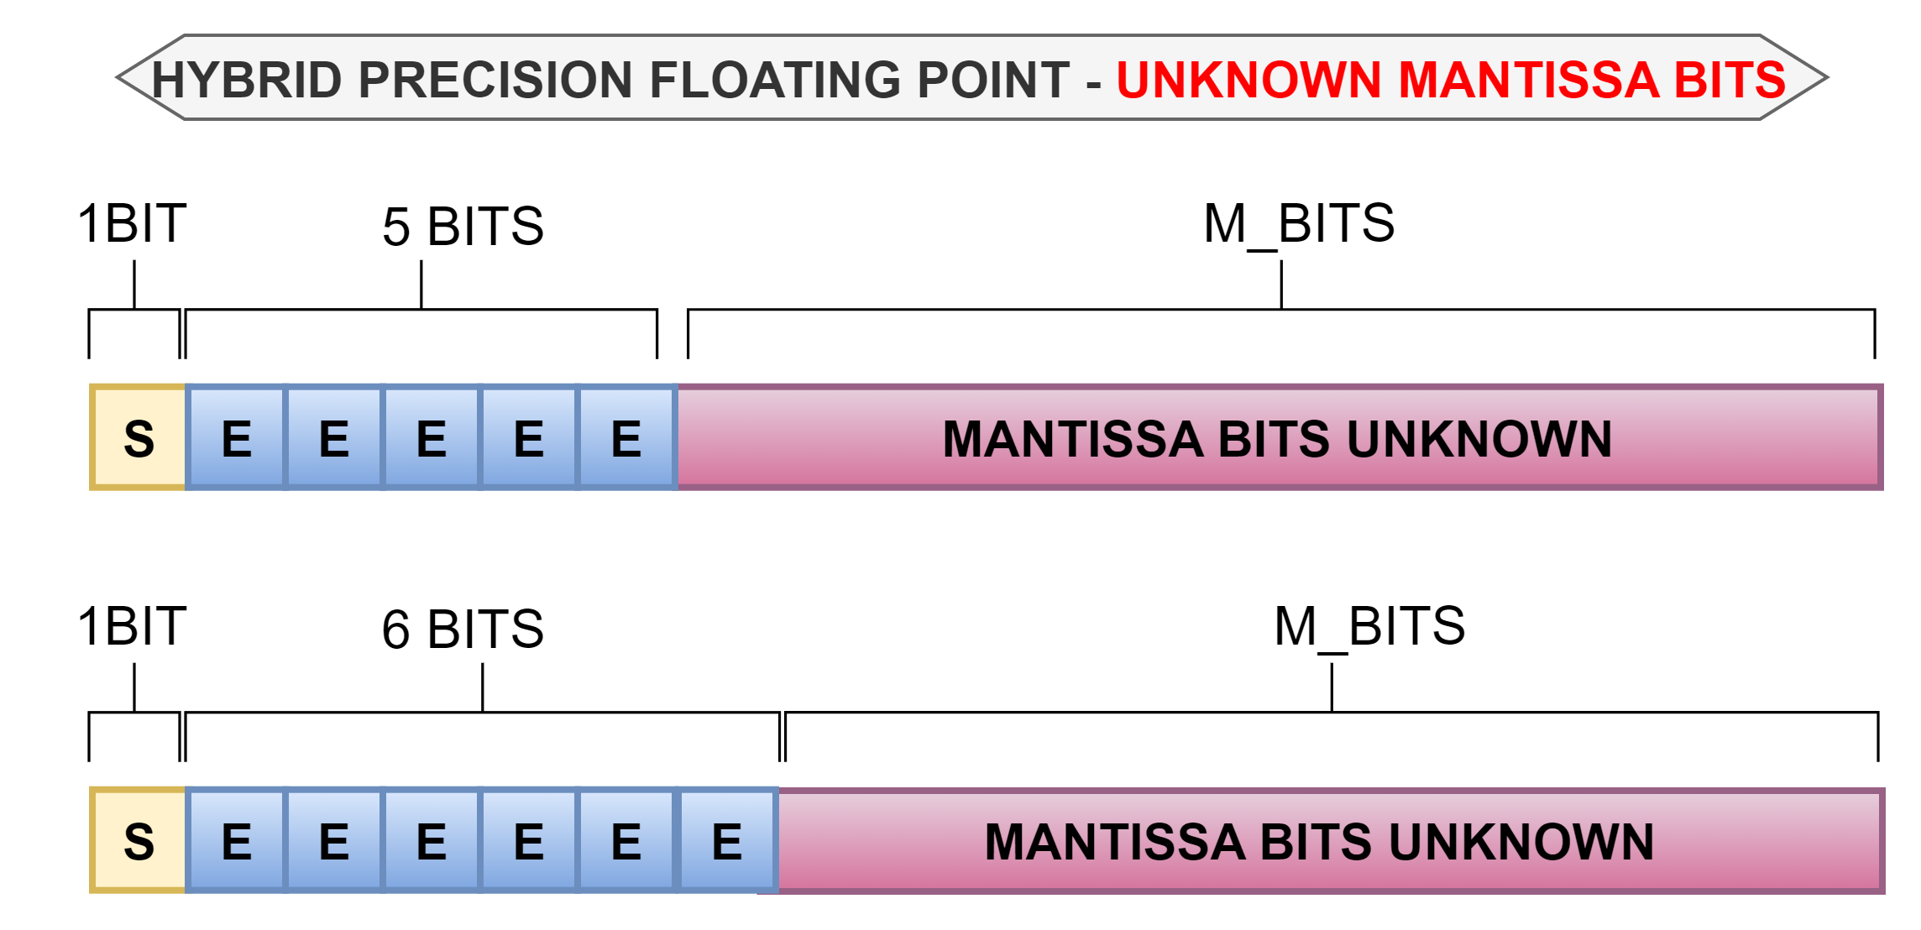
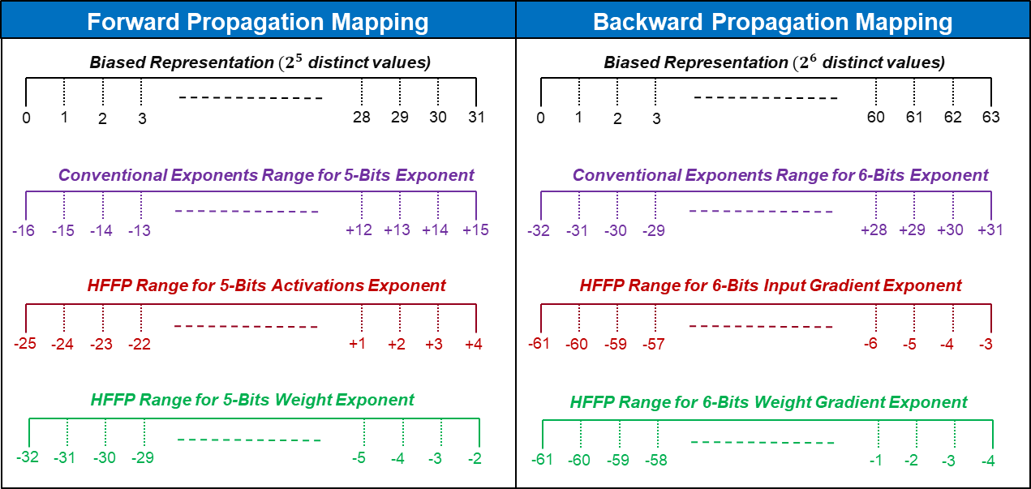
Step 2: Mantissa Optimization
Notes:
Now the algorithm has determined the optimal exponent width for Images, weights and Gradients. Next step is to find the optimal bits for Mantissa.

Slide 14
mantissa width optimization - algorithm
Hardware oriented
Identifies the minimum mantissa width satisfying the accuracy threshold across all layers
Notes:
The algorithm starts by reducing the mantissa width drastically using division. Then, it calculates the effect of the reduction. If the mAP degradation is less than the allowed threshold, it will opt for more aggressive reduction in the next iteration. If it violates the threshold, the mantissa width will go to the fine-tuning phase to find the mantissa width that satisfies the threshold.

Slide 15
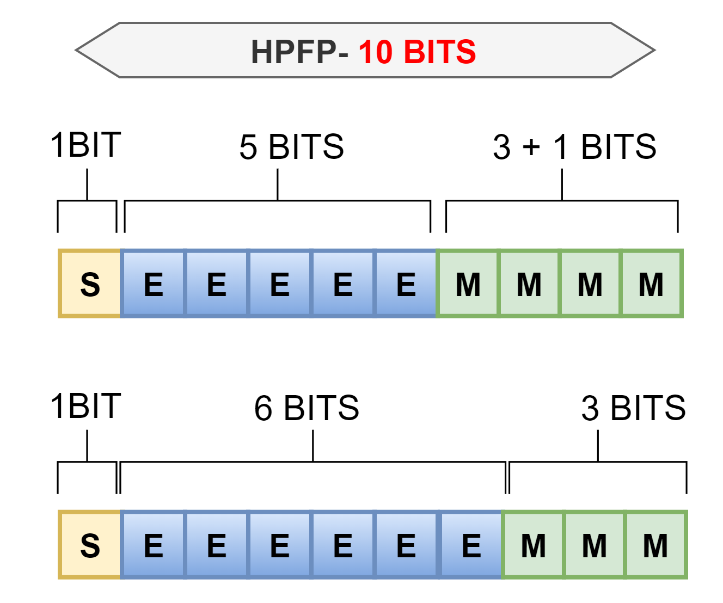
Step 3: Reduction of Accuracy Degradation
Hybrid Precision Floating Point (HPFP_{MIN}) Format is determined as:
FW: (1, EXP_{WEIGHT}, MIN – EXP_{WEIGHT} -1) / (1, EXP_{ACT}, MIN – EXP_{ACT} -1)
BW: (1, EXP_{WT_GRAD}, MIN – EXP_{WT_GRAD} -1) / (1, EXP_{IN_GRAD}, MIN – EXP_{IN_GRAD} -1)
Allowed mAP degradation is 2% while HPFP10 had 1.8%
Further Improvement in accuracy → without reducing memory bandwidth
Notes:
After finding the exponent and mantissa widths that satisfy the degradation threshold, I studied the areas which can further improve the accuracy without increasing the data path.

Slide 16
Optimal Mantissa Width - Analysis
Quantization errors in HPFP_{MIN} multiplication
Before accumulation, the multiplication result is converted back to HPFP_{MIN}
Small errors in each multiplication → Accumulate into large error
Increasing mantissa width for accumulation → Reduced Quantization Errors
Converting back to HPFP_{MIN} after accumulation introduces some quantization noise, but major accumulation errors are minimized
Notes:
One way to improve the accuracy is by addressing the issue of small quantization errors in multiplication which accumulates into large errors and degrading the overall accuracy. By increasing the precision in accumulation these errors can be minimized. And by converting the accumulation results back to optimal mantissa width we can keep the benefits of optimized data path.

Slide 17
Layer-wise Arithmetic Mantissa Optimization
Coordinate Descent Algorithm → One layer at a time, retain previous results
Notes:
I developed a coordinate descent algorithm for layer-wise mantissa optimization. The algorithm calculates the impact of each layer by increasing the mantissa width and calculating its effect on accuracy. Then, it sorts the layers based on their impact scores in descending order. Next, it gradually increases the mantissa width and checks the improvement. If the improvement by increasing the mantissa width of this layer is not significant, it uses the minimum mantissa width for that layer.

Slide 18
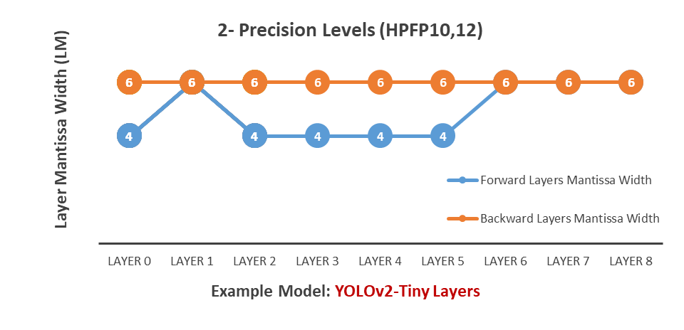
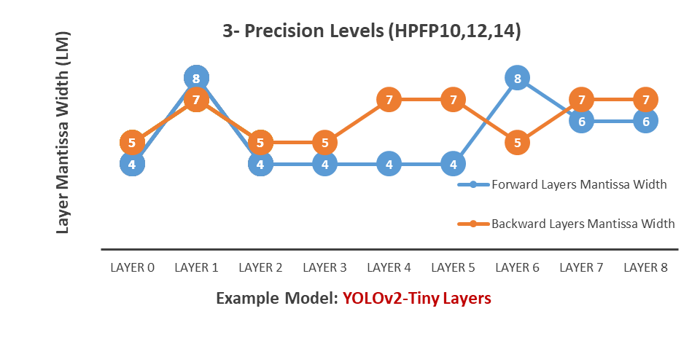
Layer-wise Optimization: Example Experiments
2- Precision Levels Optimization → HPFP₁₀ , HPFP₁₂
(1, EXP_{FW} = 5, Mantissa_{FW} = 4,6) ; (1, EXP_{BW} = 6, Mantissa_{BW} = 3,5)
3- Precision Levels Optimization → HPFP₁₀ , HPFP₁₂ , HPFP₁₄
(1, EXP_{FW} = 5 , Mantissa_{FW} = 4,6,8) (1, EXP_{BW} = 6, Mantissa_{BW} = 3,5,7)
Notes:
These are the example experiments for 2-Precision levels and 3-Precision Levels for YOLOv2-Tiny. In 2 Precision level if we look into blue line, the algorithm only increased the mantissa width for layers which it determines has more impact.

Slide 19
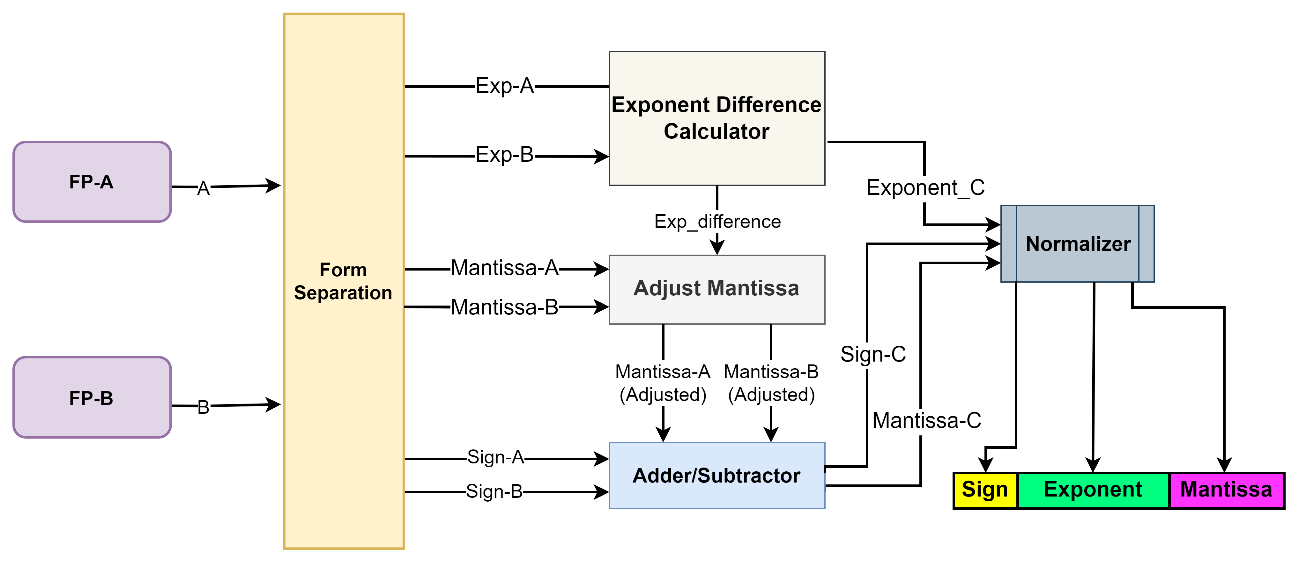
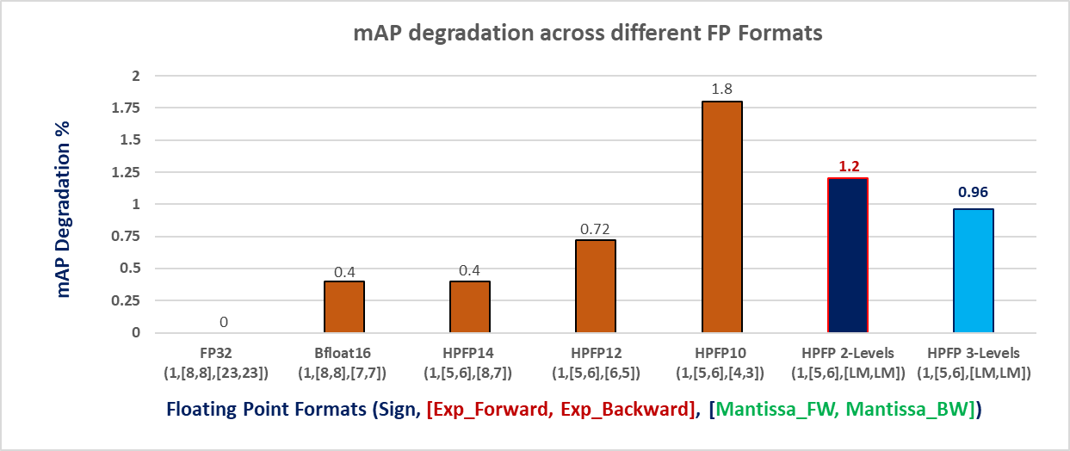
Software verification
Parameterized CUDA Libraries
Converts IEEE 32-bit floating point format into any configuration
E.g. A x B → {Sign_{A} XOR Sign_{B}, Man_{A} x Man_{B}, Exp_{A} + Exp_{B} - Bias}
E.g., 10.375 × 0.625 = 6.484
1.0100110 × 2³
× 1.0100000 × 2⁻¹
-----------------------------------------
10100110
+ 10100110
-----------------------------------------
1.10011111000000 × 2²
=1.1010000 × 2² = 6.5
Notes:
To verify my model with custom FP operations I have developed flexible CUDA libraries that convert IEEE 32-bit floating-point format into any configuration of exponent and mantissa bits. It also allows for custom asymmetric exponent range. For example, if we simply use A×B, Python or PyTorch would perform the operation on either FP32 or INT8. With these CUDA libraries, all arithmetic operations are performed in custom floating point formats by operating on the sign, exponent, and mantissa separately. These results show that our minimum hybrid precision floating point format, HPFP10, has degradation less than the allowed training degradation for our autonomous car project. Our 2-level HPFP and 3-level HPFP formats have further reduced this degradation to make it more accurate.

Slide 20
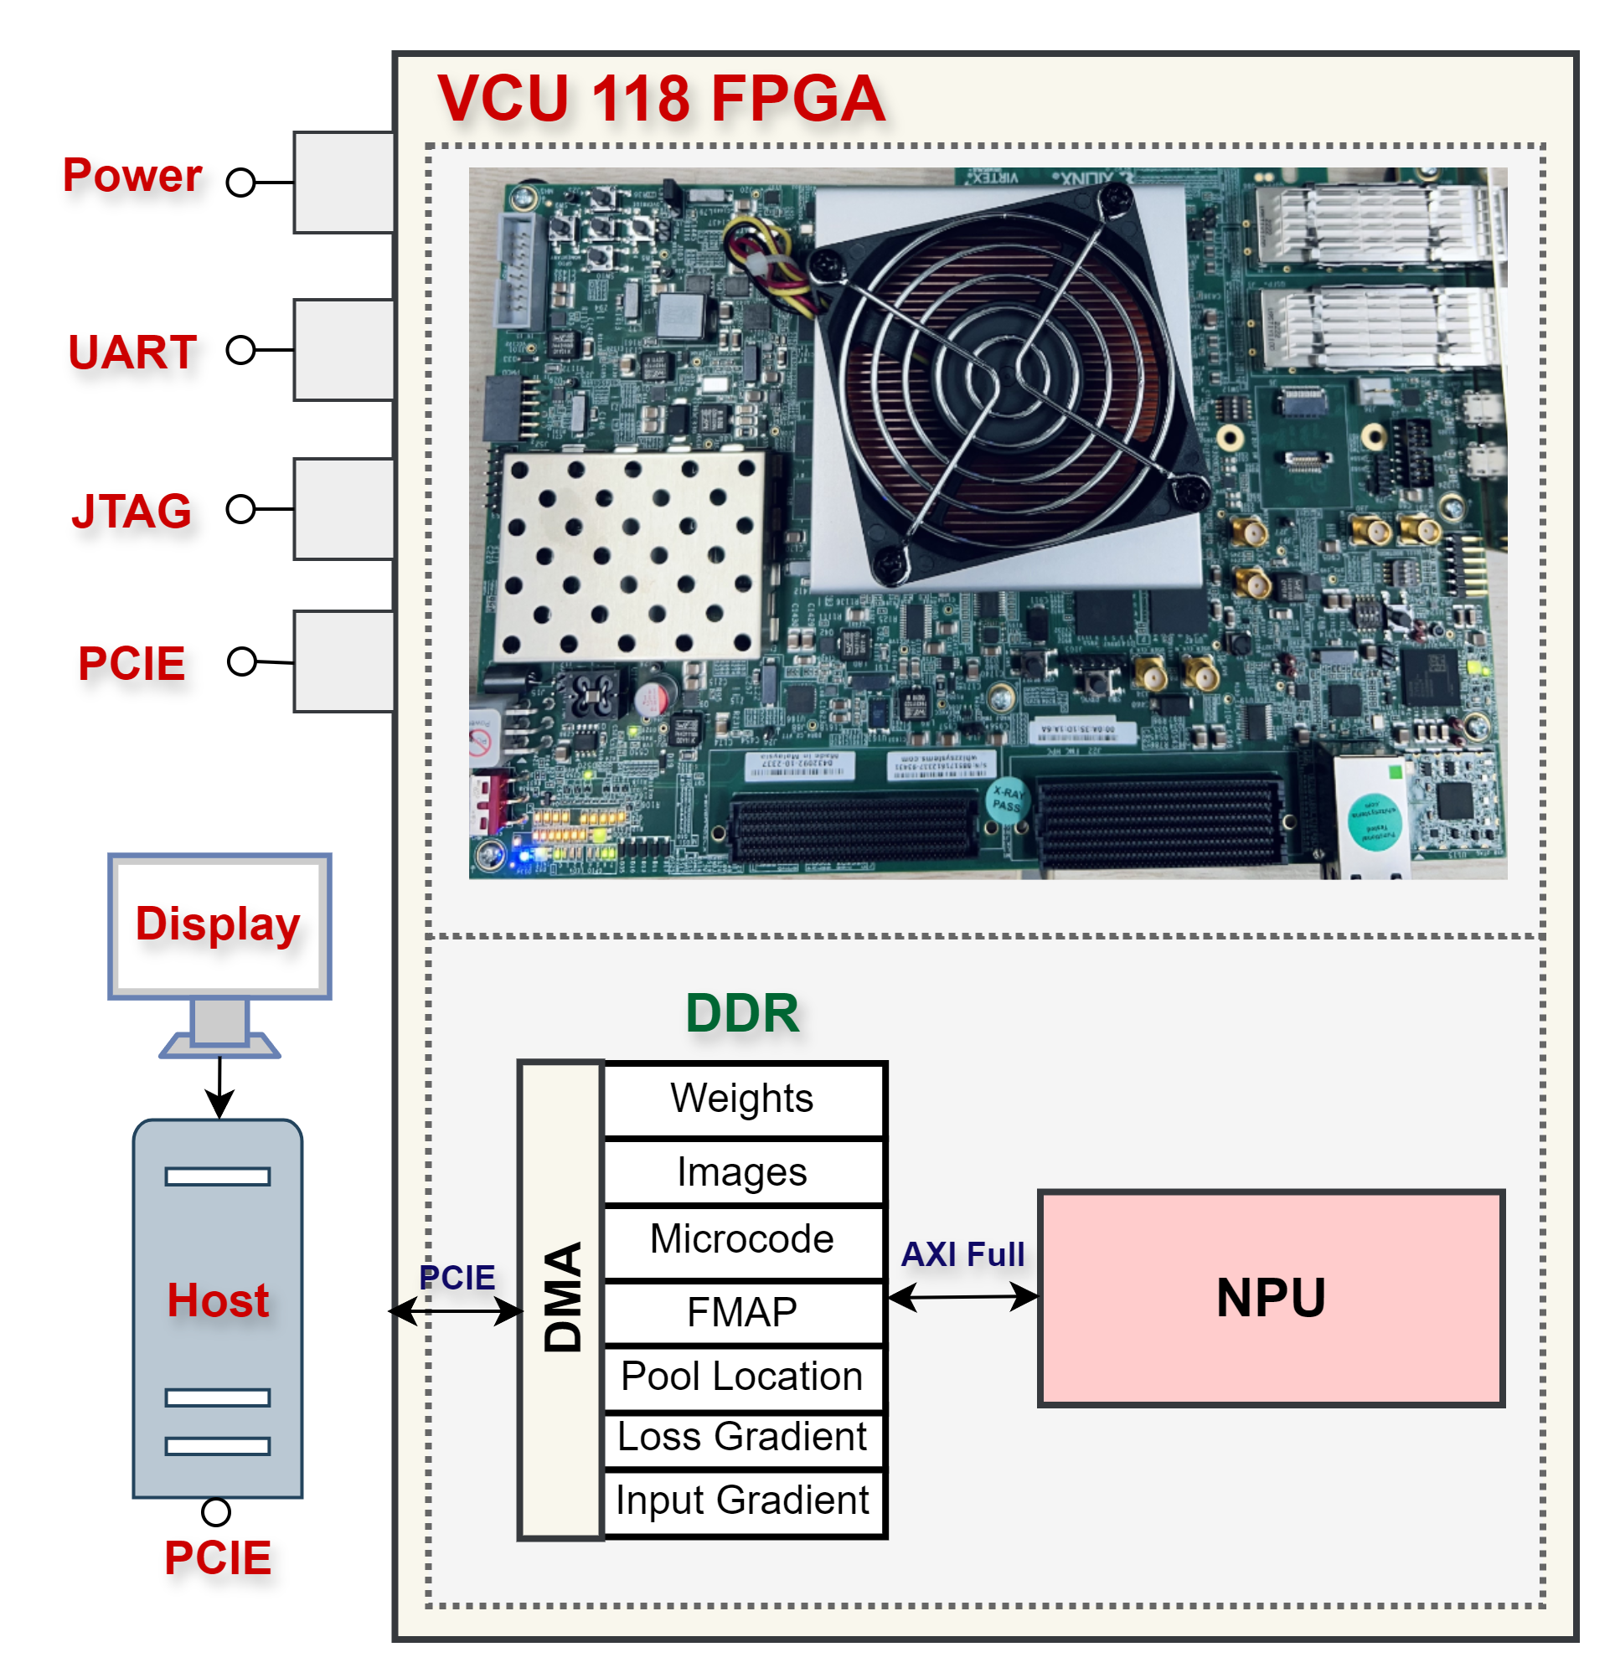
Hardware/Software co-design Evaluation Setup
Host PC → PCIE → DDR
Weights
Input FMAP (Images)
Microcode (Instruction Set)
NPU
Processes Forward layers
Sends final FMAP to PC
Host PC
Calculate Loss
Sends Loss Gradient → DDR
NPU
Processes Backward Layers
Host PC
Update weights
Send updated weights
Notes:
To evaluate it on hardware, I have used FPGA VCU118 and linux server. The data is sent from server via PCIE interface to DRAM and then processed by NPU

Slide 21
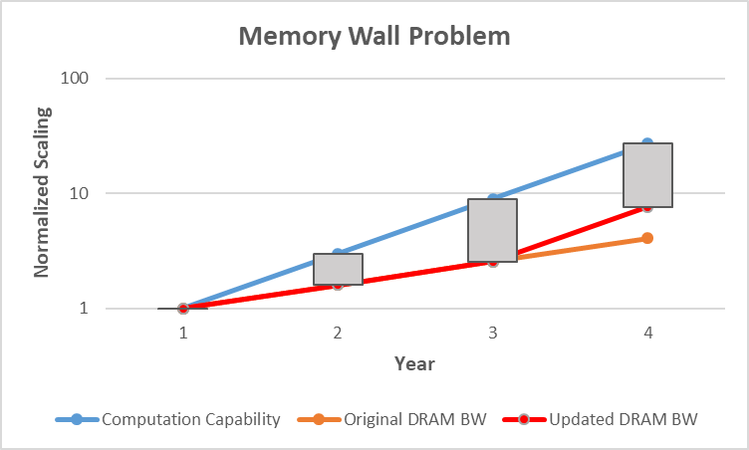
Hardware comparison with related works
2- Precision Levels HPFP vs Bfloat16
37.5% increased DRAM Speed (1.375x)
(4 In Channel, 16 Out Channels, 4x16x9 PEs)
23.5% Faster Processing (Computation + Memory)
49.4% reduced energy, 37.2% reduced LUTs
Reduced Gap
H. Shao, J. Lu, J. Lin, and Z. Wang, "An FPGA-Based Reconfigurable Accelerator for Low-Bit DNN Training," 2021 IEEE Computer Society Annual Symposium on VLSI (ISVLSI), Tampa, FL, USA, 2021, pp. 254-259, doi: 10.1109/ISVLSI51109.2021.00054.
Junaid, M.; Arslan, S.; Lee, T.; Kim, H. Optimal Architecture of Floating-Point Arithmetic for Neural Network Training Processors. Sensors 2022, 22, 1230.
J. Lu, C. Ni and Z. Wang, "ETA: An Efficient Training Accelerator for DNNs Based on Hardware-Algorithm Co-Optimization," in IEEE Transactions.
Park, Sangbo (2024). Reconfigurable CNN Training Accelerator Design Based on Efficient Memory Access Reduction Techniques. [Master’s Thesis].
Notes:
By comparing the hardware implementation of this design with our previous design in the same year, we found that despite having similar computation capabilities, we were able to reduce the gap between computation capability vs memory’s ability to provide data to processing elements. Due to optimized arithmetic's energy is reduced 49.4% and LUTs by 37.2%

Slide 22
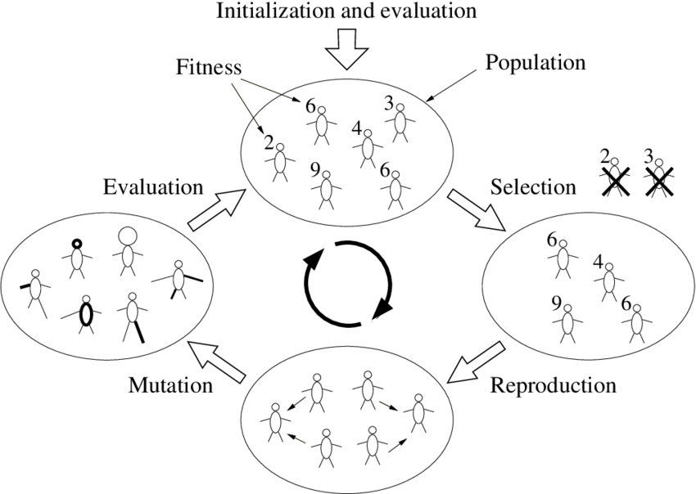
Floating Point Optimization for CNN Inference Accelerator
Section 3: Thesis Chapter 4
GOALE: Genetic (Mantissa) Optimization and Asymmetric Layer-wise Exponent
Notes:
This section explains the Chapter 4 of my Thesis. The method used in this section is called Genetic Mantissa Optimization and Layer wise Asymmetric Exponent Optimization

Slide 23
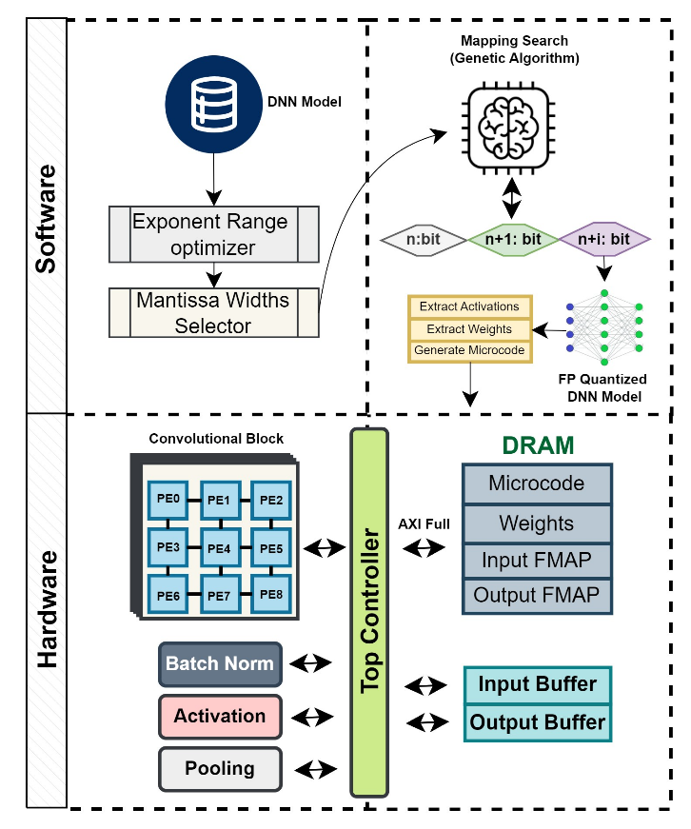
GOALE: Genetic (Mantissa) Optimization and Asymmetric Layer-wise Exponent
Comparison to Previous Inference Accelerators
Feature | Previous Works | GOALE
Asymmetrical Exponent | INT/Symmetric/data-type | Layer-wise Asymmetric
Layer-wise Mantissa Optimization | Linear | Genetic Algorithm
Solution Convergence Time | Very High/ High | Medium
Contributions
Layer-wise Asymmetric Bias Adjusted
Centered around the mean of the exponent distribution
Standard Deviation to find the range of exponents
Genetic Algorithm to Optimize Mantissa Width
Mantissa widths are used as Genes.
Calculating the mantissa widths that meet the Signal-to-Quantization Noise Ratio (SQNR) within each layer
Every layer’s Gene is combined to make chromosomes.
Notes:
This method address the challenges of previous accelerator. In previous Inference accelerators, Integers are used or symmetric exponents are used. My previous method used asymmetric based on data type e.g. Image, Weight, Gradients. Layer wise asymmetrical exponent based on standard deviation is proposed. The methods for layer wise optimization are linear and their convergence time is very high. In this design I will utilize Genetic Algorithm to more effectively optimize the mantissa for each layer.

Slide 24
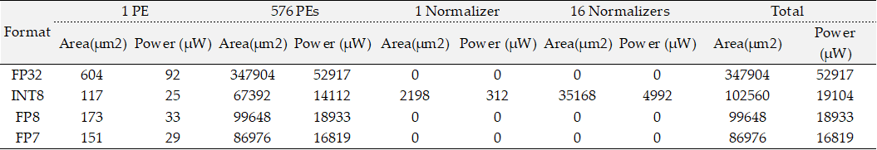
Feasibility Analysis
Floating Point vs Integer hardware
Example Configuration 1:(4 In Channel, 16 Out Channels, 16x4x9 PEs)
Integer MAC Units have smaller areas than floating point MAC.
Integer and floating-point quantization require normalization.
E.G., 8B INT x 8B INT = 16B INT→ normalization to make 8B again.
In FP quantization, when Mantissa is multiplied:
4B Mantissa x 4B Mantissa = 8B Resultant Mantissa
To make it 4B again, a simple mantissa shift and exponent adjustment can be embedded within PE.
In this configuration, as compared to INT8 → FP8 has:
2.83% Reduced area
0.89% Reduced Power Consumption
Notes:
Since most of Inference accelerators are based on Integers, therefore I have analyzed the feasibility of Floating point accelerator. FP MAC units generally have a larger area than integer MAC units. However, when multiplying two integer numbers, the resultant number needs to be normalized. Normalizers typically require computationally expensive dividers. The overall design, after incorporating the normalizer, becomes comparable to an FP design. In our case, the integer-based design is even less efficient.

Slide 25
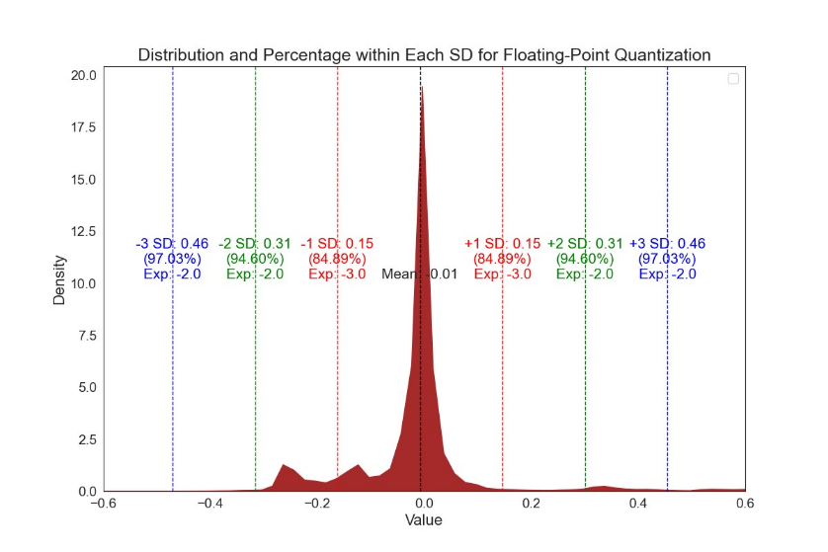
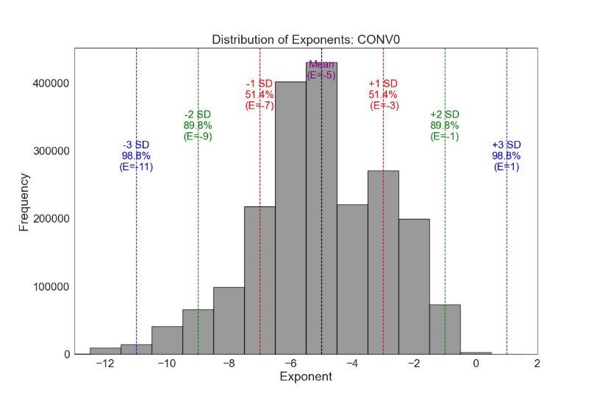
Exponent Width Optimization:
Distribution Analysis
CNNs characteristics → closer to Gaussian or Leptokurtic distributions
84% of the data clusters around the mean in Leptokurtic distributions
Traditional clipping methods → insufficient even at 3 Standard Deviations
Min Exponent = -3, Max Exponent = ?
Analyzing the exponent distribution instead of the data distribution
Min Exponent = -11, Max Exponent = +1
Covers 98.8% of the data at 3 Standard deviations
YOLOv2 Tiny Layer 0 Output FMAP Real Values
YOLOv2 Tiny Layer 0 Output FMAP Exponent
Notes:
Before optimizing the exponent width, we need to analyze the distribution of our CNN model. As shown in Figure 1, more than 80% of the data is clustered around the mean. Traditional methods of clipping the range do not provide information about the minimum and maximum exponents because the exponent is symmetric around the mean. I propose a better method to evaluate the exponent distribution instead of the real value distribution. This approach allows us to easily identify the exponent ranges where most of our data resides.

Slide 26
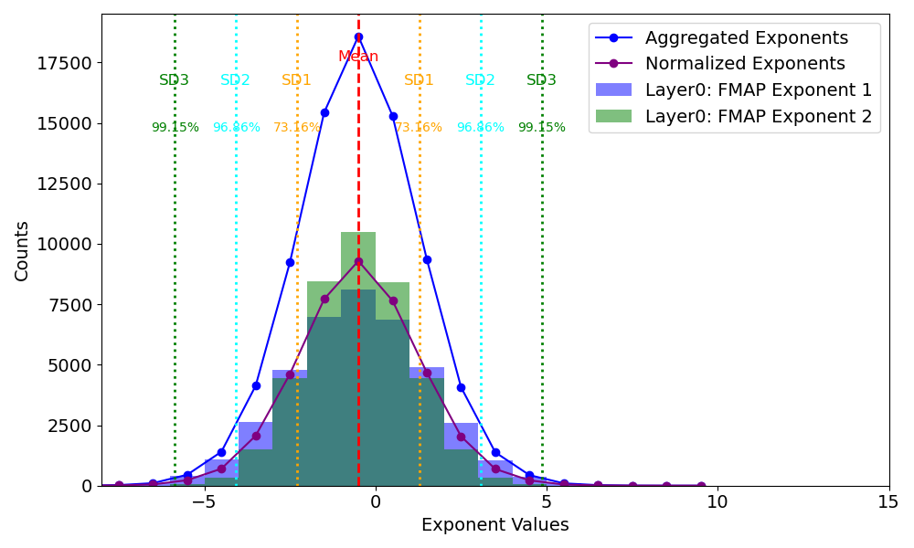
Exponent Width Optimization:
Exponents Aggregation
For Inference, weights remain constant
Feature MAPs (FMAPs) change based on input image.
Output of Convolution/Fully Connect layer
To identify the trend for the range of exponents:
Aggregate the exponent distributions for all FMAPs within each individual layer.
Normalize by dividing by the total number of exponents across all FMAPs in that layer.
YOLOv2 Tiny Example
Clipping Range | mAP @ 0.5
1 SD | 8%
2 SD | 23%
3 SD | 57.39
No Clipping/Base | 57.46
The total number of FMAPs
for each layer is equal to the
total number of input images.
Notes:
For inference, since the weights remain the same for each layer, we can directly optimize them. However, for each image, we have different feature maps. Therefore, we first need to aggregate the count of each exponent of all feature maps in that layer and then calculate their standard deviation. Initially, we clip the range outside 1 standard deviation, then outside 2 standard deviations, and so on until the target accuracy is achieved. As shown in the table, after clipping 3 standard deviations, the accuracy is very close to the baseline accuracy.

Slide 27
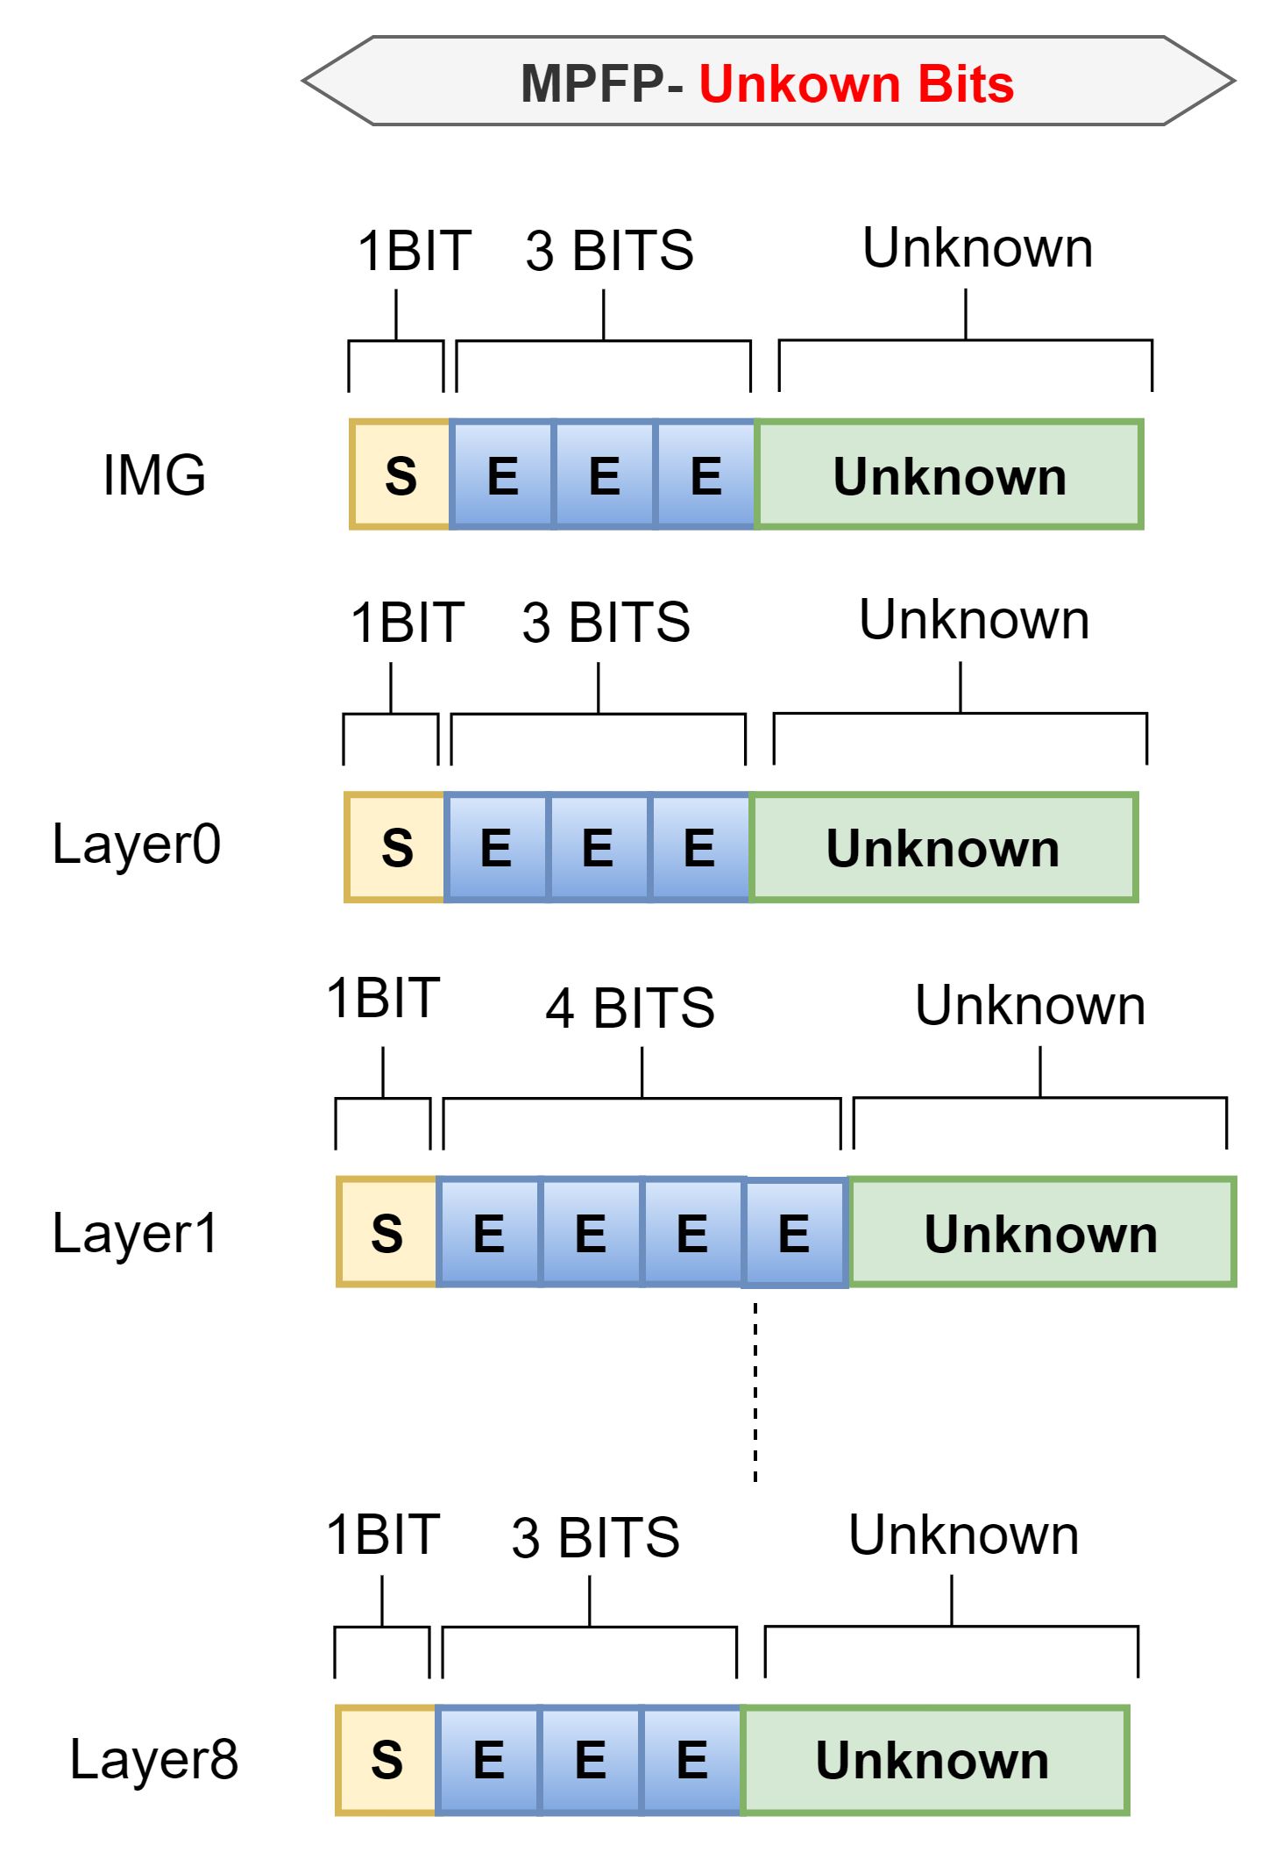
Layer Wise Mantissa Optimization
Notes:
Now the algorithm has determined the optimal exponent width for all layers. Next step is to find the optimal bits for Mantissa.

Slide 28
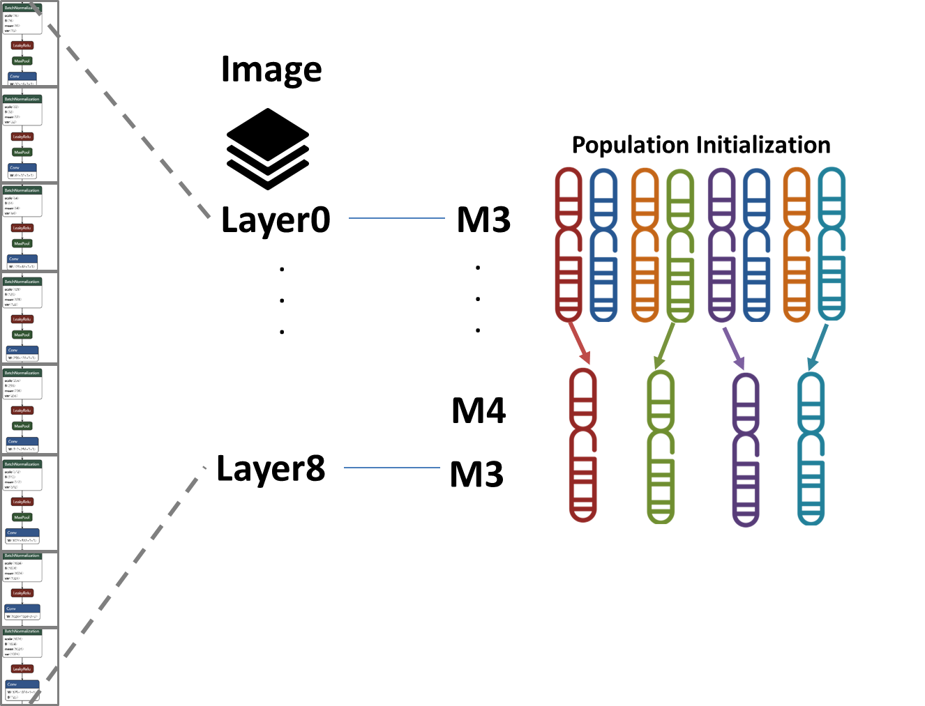
Mantissa Optimization using genetic algorithm
NVIDIA FP4 for LLMs and GOOGLE’s Bfloat16 for CNNs
YOLOv2 Tiny needs Quantization for input Image and Output Activations (9 layers).
Total Combinations = Quantization Levels^{(Total Layers+1)}
12⁽⁹⁺¹⁾ = 6.2 Trillion Combinations !
Genetic Algorithm(GA) for Combinatorial Optimization
Efficiency: navigates through combinations by leveraging crossover and mutation to explore and exploit the solution space dynamically
Scalability: The probabilistic approach allows for handling complex optimization problems with a high-dimensional search space like the one presented.
Gene: Mantissa Width of a single layer {M1,M2,M3 ….}
Chromosome: Combination of Genes for Total Layers
Population: # of Chromosomes
Fitness: Accuracy / mAP
Selection: Highest Fitness (Elitism)
Mutation: Randomly Change Genes to avoid Local Min/Max
Cross-over: for Diversity
Notes:
Layer-wise mantissa optimization involves a very large and complex search space. Therefore, in my proposed method, I will utilize a Genetic Algorithm to effectively navigate valuable regions and quickly find a near-optimal solution. In this method, the mantissa width of a single layer is used as a gene, and the combination of these genes across all layers is referred to as a chromosome.

Slide 29
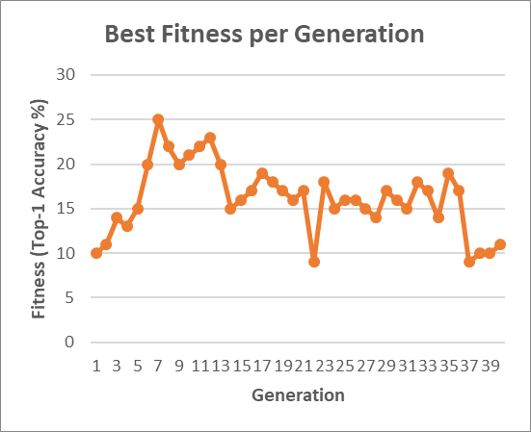
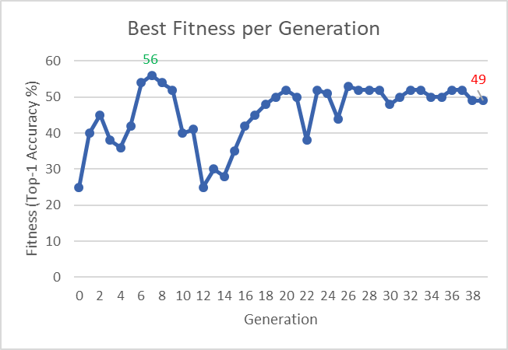
Genetic Algorithm
(Quality aware optimization)
Sub-Optimal Solution using random population initialization
Randomly selecting genes (mantissa widths) and creating random chromosomes can lead to suboptimal solutions.
AlexNet: Mantissa Width 2,3,4,5
AlexNet: Mantissa Width 3,4,5
A systematic approach is required for determining the minimum and maximum mantissa width.
To Find Maximum Mantissa Width
Uniform Quantization
To Find Minimum Mantissa Width
Coordinate Descent Algorithm to find SQNR Threshold
Greedy Algorithm to find layer-wise initial mantissa widths
Notes:
If we randomly initialize the population, there is a high chance of never reaching an optimal solution. Therefore, to perform a quality-aware optimization, we will first determine the maximum and minimum mantissa widths. These values will be used as the initial genes passed to our genetic algorithm.

Slide 30
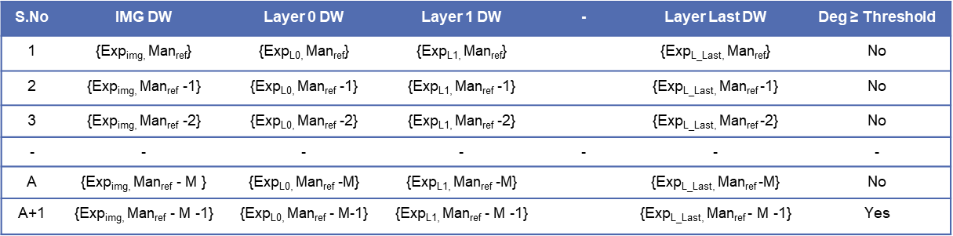
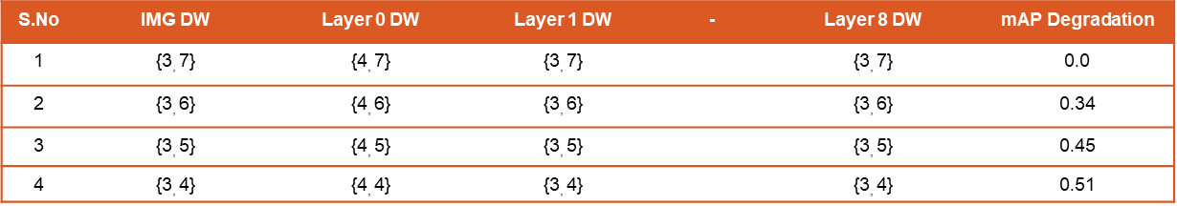
Determining Max Mantissa Width:
Uniform Quantization
To find maximum mantissa width based on Accuracy/mAP analysis:
A reference mantissa width is reduced linearly:
Pre-determined exponent width, using Exponent Optimization Algorithm
Degradation Threshold for Uniform Precision Inference is 0.5%, while for training and mixed precision Inference is 2%.
Best Case in terms of accuracy → Need smaller data width for HW
Notes:
Since the exponent width of each layer is already determined, we will linearly reduce the mantissa width uniformly across all layers. The last mantissa width that satisfies the uniform precision degradation threshold will be used as the maximum mantissa width, ensuring the best possible accuracy.

Slide 31
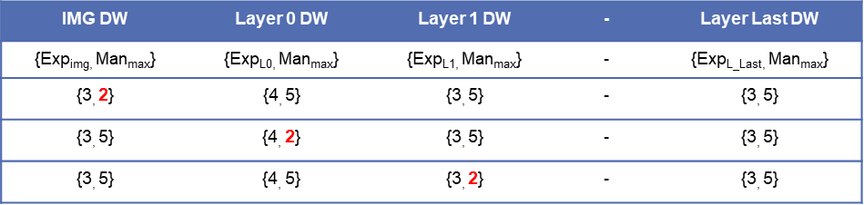
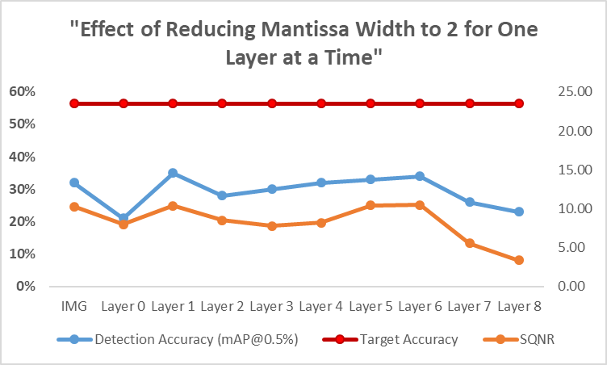
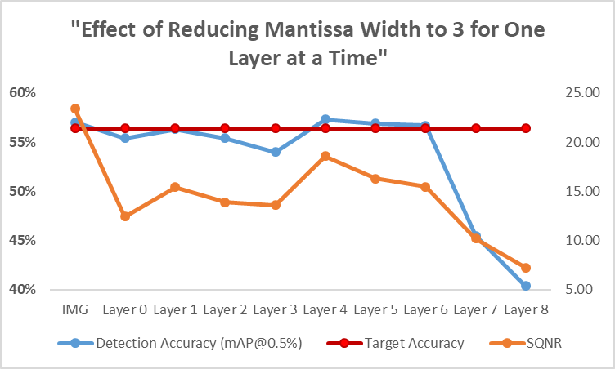
2. Finding Minimum mantissa width:
coordinate descent Quantization with restoration
SQNR Threshold will be used to find the minimum width for each layer
Calculate SQNR and accuracy/mAP both to determine relationship
For all layers Man_{max} = Man_{ref} – M will be used:
One layer at a time is reduced to a smaller mantissa width
Notes:
To find the minimum mantissa width for each layer, we will first determine the relationship between accuracy and Signal-to-Quantization-Noise Ratio (SQNR). I have used coordinate descent quantization method which reduces the mantissa width of one layer at a time while keeping the others at their maximum width. This process is repeated for each layer. As shown in the first graph, when the SQNR is low, the solution never reaches the target accuracy. However, for SQNR above a certain threshold, the solution consistently reaches the target accuracy. We will use this SQNR threshold to generate the initial chromosomes for our genetic algorithm.

Slide 32
3. Initial Chromosomes Generation:
Greedy Algorithm (Mantissa Width based on SQNR)
Optimize one layer at a time based on SQNR Threshold
(Local Decisions)
Notes:
The initial Chromosomes will be generated by this Greedy algorithm which will use SQNR Threshold as parameter instead of accuracy. I will explain this with illustrative example

Slide 33
3. Initial Chromosomes Generation:
illustration
All Genes (mantissa width) in each Chromosome satisfy SQNR Threshold
Only for that specific image
YOLOv2-Tiny Example with 9 layers and 5000 Validation Image dataset
Identify one chromosome which performs well for all images
High Accuracy and Low number of bits for each layer
Greedy algorithm → Limited Exploring Capability
Notes:
The purpose of this algorithm is to generate the initial chromosomes where each layer satisfies the SQNR threshold. In this YOLOv2 example, the algorithm produced 5000 initial chromosomes based on the validation dataset. We now need one chromosome that performs well across all images and utilizes low hardware resources. With these initial chromosomes, we are ready to proceed with the Genetic Algorithm.

Slide 34
Genetic Algorithm:
1. Population Initialization
(Chromosomes satisfying SQNR)
Mantissa Widths are Genes
L0-L_Last represents Mantissa Width for Output FMAP of a General CNN
Notes:
The first step in the Genetic Algorithm is to establish the initial population based on these initial chromosomes. In this example, out of the 5000 initial chromosomes, the algorithm randomly selected 100 chromosomes to form the initial population

Slide 35
Genetic Algorithm:
2. Fitness Calculation
Fitness
Calculated by dividing accuracy/mAP with the sum of mantissa widths to find the balance between accuracy and hardware
Notes:
The second step is to evaluate the fitness of this initial population. Since the goal of this algorithm is to minimize hardware resources, I calculate fitness by dividing the accuracy by the sum of the mantissa widths. Since fitness is directly proportional to accuracy and inversely proportional to the sum of the mantissa widths, we will achieve a solution with a balanced high accuracy and low mantissa width. For example, 1st indiviual, although the accuracy is high, the fitness score is lower compared to 100th individual with a smaller mantissa width. Similarly, for 2nd individual, the sum of the mantissa widths is lower, but due to high accuracy, this solution has higher fitness.

Slide 36
Genetic Algorithm:
2. Parents Selection
The algorithm selects the parent with the highest fitness score.
The number of parents is twice to produce enough offspring to replace the entire population
Parent 1
Parent 2
P(P_Size*2)
P3
P4
P(P_Size*2)-1
Parent 1
Parent 2
P200
P3
P4
P199
Notes:
The second step is parent selection. The algorithm selects the parents with the highest fitness scores. The total number of parents is twice the size of the population to produce enough offspring to replace the old population.

Slide 37
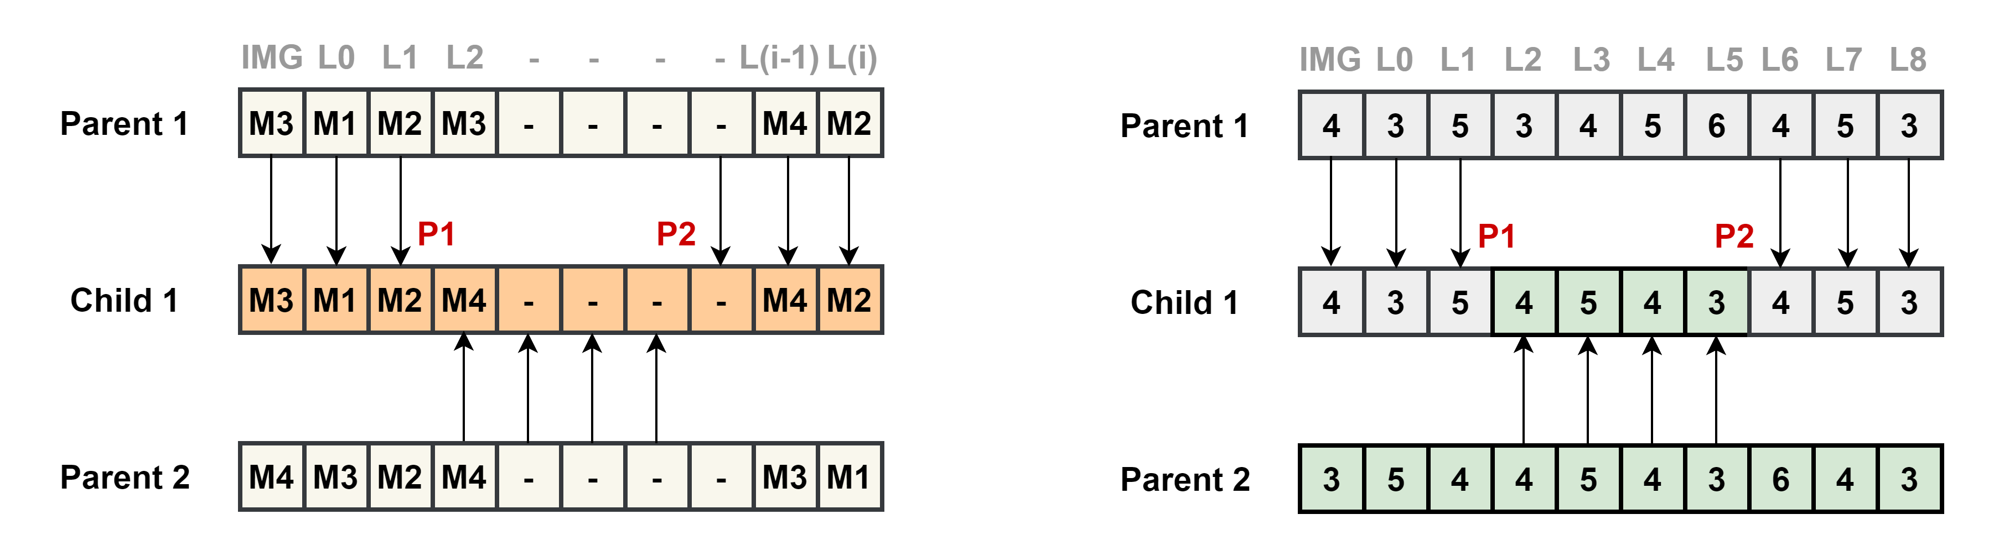
Genetic Algorithm:
3. Two-point Crossover
Two-Point crossover method is employed.
Segments of the precision settings (Genes) are inherited from different parents, increasing genetic diversity.
Faster convergence while avoiding the local optima problem in fixed (one-point) crossover.
Two-Point Crossover: Broader exploration

Slide 38
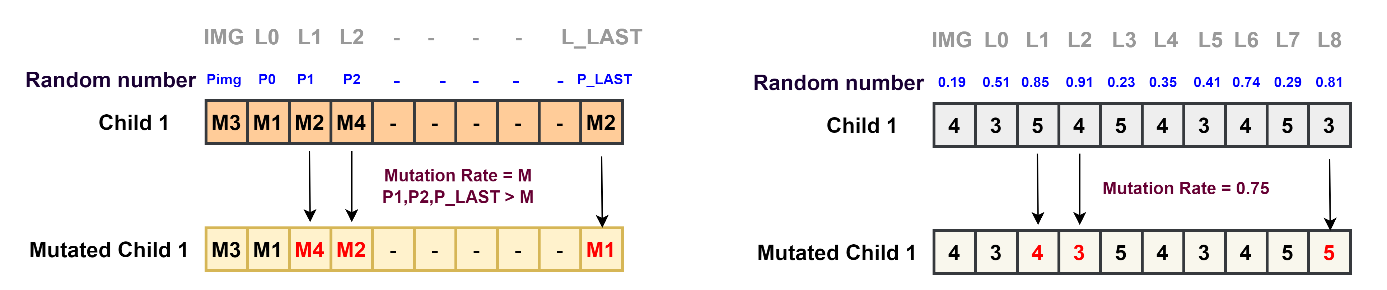
Genetic Algorithm:
4. Mutation
The algorithm generates a random number between 0.0 and 1.0
It then compares this number to the mutation rate
If random number is greater than mutation rate, mutation occurs.
The gene under mutation is replaced with a new value randomly selected from Precision set.

Slide 39
Genetic Algorithm for Mantissa Optimization
(Chromosomes satisfying SQNR)

Slide 40
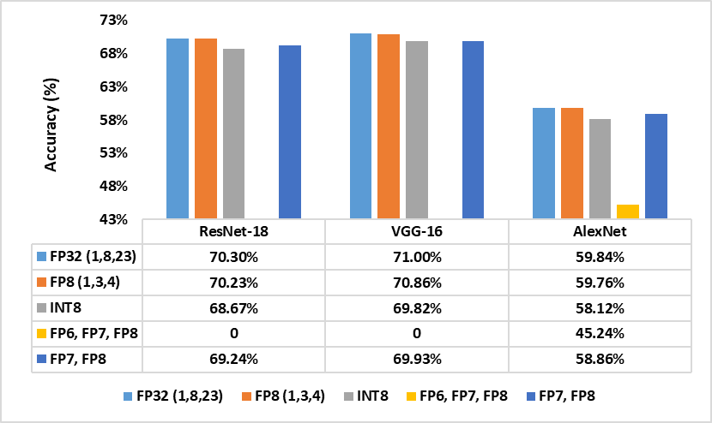
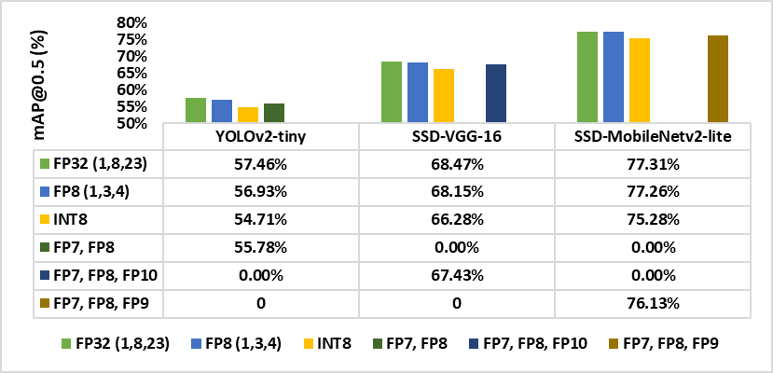
Software Verification
3 Classification and 3 Object Detection Algorithms were evaluated
Comparable Accuracy with baseline FP32
FP8 and Mixed Precision Outperformed INT8 for all models
NA
NA
NA
NA
NA
NA
NA
NA
NA
NA
NA
NA
NA
NA
Due to limited work on Mixed Precision, GOALE is compared with Integer 8
After modifying the SQNR threshold, ALEXNET gave better results

Slide 41
Hardware comparison with related works
Our Mixed Precision FP (7, 8-bits) vs 16-bit fixed
50% Reduced DRAM access
32% Faster Processing (Computation + Memory)
65% reduced energy, 46% reduced LUTs
Minimum Energy per image than all existing methods including INT-8
Pure FP8 = 772 µj
14.5% Reduced energy
Huang, Hongmin, et al. "Design space exploration for yolo neural network accelerator." Electronics 9.11 (2020): 1921.
T. Adiono, A. Putra, N. Sutisna, I. Syafalni and R. Mulyawan, "Low Latency YOLOv3-Tiny Accelerator for Low-Cost FPGA Using General Matrix Multiplication Principle," in IEEE Access, vol.
T. Adiono, R. M. Ramadhan, N. Sutisna, I. Syafalni, R. Mulyawan and C. -H. Lin, "Fast and Scalable Multicore YOLOv3-Tiny Accelerator Using Input Stationary Systolic Architecture," in IEEE Transactions on Very Large Scale Integration (VLSI) Systems, vol. 31, no. 11, pp. 1774-1787, Nov. 2023, doi: 10.1109/TVLSI.2023.3305937.
Park, Sangbo, “Reconfigurable CNN Training Accelerator Design Based on Efficient Memory Access Reduction Techniques,” M.S. thesis, Chungbuk National University, Cheongju, Republic of Korea, 2024.

Slide 42
Conclusion/Key differences in each method
DREAM: Dynamic (Mantissa) Reduction and Exponent Asymmetric Method
Dynamic Mantissa Reduction for Uniform Precision → E.g. {23, 11, 5, 3}
Layer-wise different Mantissa width for Accumulation, Uniform precision for data path
Different Asymmetric Exponent based on data types and their range:
Weights, Activations, Input Gradient, Weight Gradient
Software/Hardware for “Classification & Object Detection Training Accelerator”
GOALE: Genetic (Mantissa) Optimization and Asymmetric Layer-wise Exponent
Layer-wise Mantissa based on Genetic Algorithm
Layer-wise Asymmetric Exponent based on standard deviation
Software verification for 3 Classification and 3 Object Detection Inference models
Verified on hardware for “YOLOv2-tiny Inference Accelerator”
Challenge | DREAM (HPFP_{(10,12,14)}) | GOALE _{(MPFP(7,8)})
DRAM Speed Increase | 37.5% | 50%
Area Reduction | 37.2% | 46%
Energy Reduction | 49.4% | 65%
Compared with same model with number of PEs in Bfloat16

Slide 43
Publications
Journals
[1] Junaid, M.; Aliev, H.; Sajid, S.; Kim, H.; Sim, S. Optimizing CNN Post-Training Quantization with Mixed Precision Floating-Point Arithmetic Using a Genetic Algorithm. IEEE Access 2024. (Under Professor Review)
[2] Junaid, M.; Aliev, H.; Park, S.; Kim, H.; Sim, S. Hybrid Precision Floating-Point (HPFP) Selection to Optimize Hardware-Constrained Accelerator for CNN Training. Sensors 2024, 24, 2145.
[3] Junaid, M.; Arslan, S.; Lee, T.; Kim, H. Optimal Architecture of Floating-Point Arithmetic for Neural Network Training Processors. Sensors 2022, 22, 1230.
[4] Lee, D.-Y.; Aliev, H.; Junaid, M.; Park, S.-B.; Kim, H.-W.; Lee, K.-M.; Sim, S.-H. High-Speed CNN Accelerator SoC Design Based on a Flexible Diagonal Cyclic Array. Electronics 2024, 13, 1564.
[5] Asghar, M.S.; Arslan, S.; Junaid, M.; S.A.A. Shah.; Kim, H.; A Convolutional Neural Network Processor with In-Situ One-Shot Analog Convolutional Unit. IEEE Transaction of Circuits and Systems II: Express Briefs 2023, (In Pipeline)

Slide 44
Publications
Conferences
[1] M. Junaid, S. A. Ali Shah, M.S. Asghar, H.W. Kim, “Optimizing Memory Access with Shift-based On-Chip Memory for Efficient Convolution Processing in analog DNNs” In Proceedings of the Institute of Electronics and Information Engineers (IEIE), Gangneung, South Korea, 10-11 August 2023. (Best Paper Award)
[2] M. Junaid, S. Shoaib, H.W. Kim, “Accuracy and Energy Analysis of CNN Training Accelerator with Various Floating-Point Formats” In Proceedings of the Institute of Semiconductor Engineers (ISE 2021), Ananti Namhae, South Korea, 12-14 July 2021.
[3] M. S. Asghar, M. Junaid, H. W. Kim, S. Arslan and S. A. Ali Shah, "A Digitally Controlled Analog kernel for Convolutional Neural Networks," 2021 18th International SoC Design Conference (ISOCC), Jeju Island, Korea, Republic of, 2021, pp. 242-243, doi: 10.1109/ISOCC53507.2021.9613851.
[4] Lee, D.; M. Junaid; Hayot; Al-Hamid, A. A.; Park, G.; Park S.; Wajahot; Kim H. Scalable CNN Accelerator SoC with Integrated RISC-V Processor Core. In Proceedings of the Korean Institute of Communication Sciences (KCS 2023), Hi-1 resort, Gangwon-do, South Korea, 12-14 February 2023.
[5] M. S. Asghar, D.; M. Junaid; H. W. Kim, S. Arslan; Kim H. Ultra-Low Power Analog CNN Accelerator SoC Based on nano-amp Current Multiplier and Max Pooling Circuit. In Proceedings of the Korean Institute of Communication Sciences (KCS 2023), Hi-1 resort, Gangwon-do, South Korea, 12-14 February 2023.

Slide 45
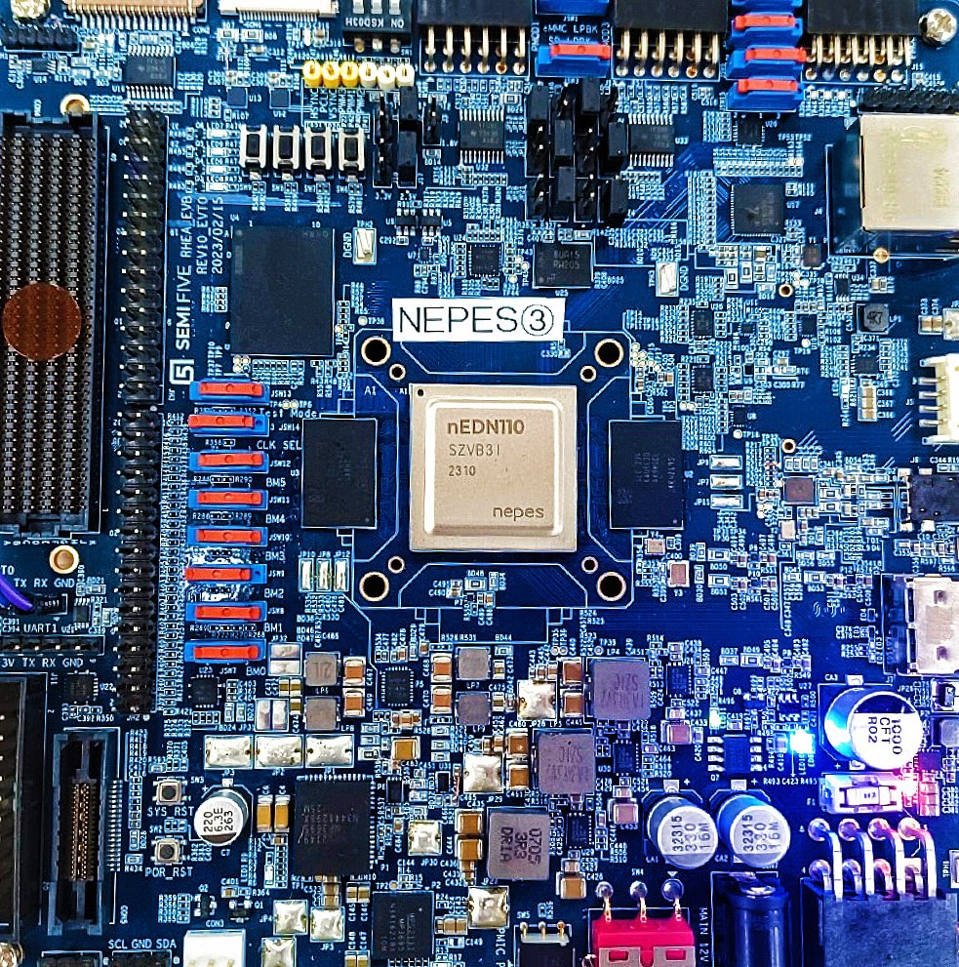
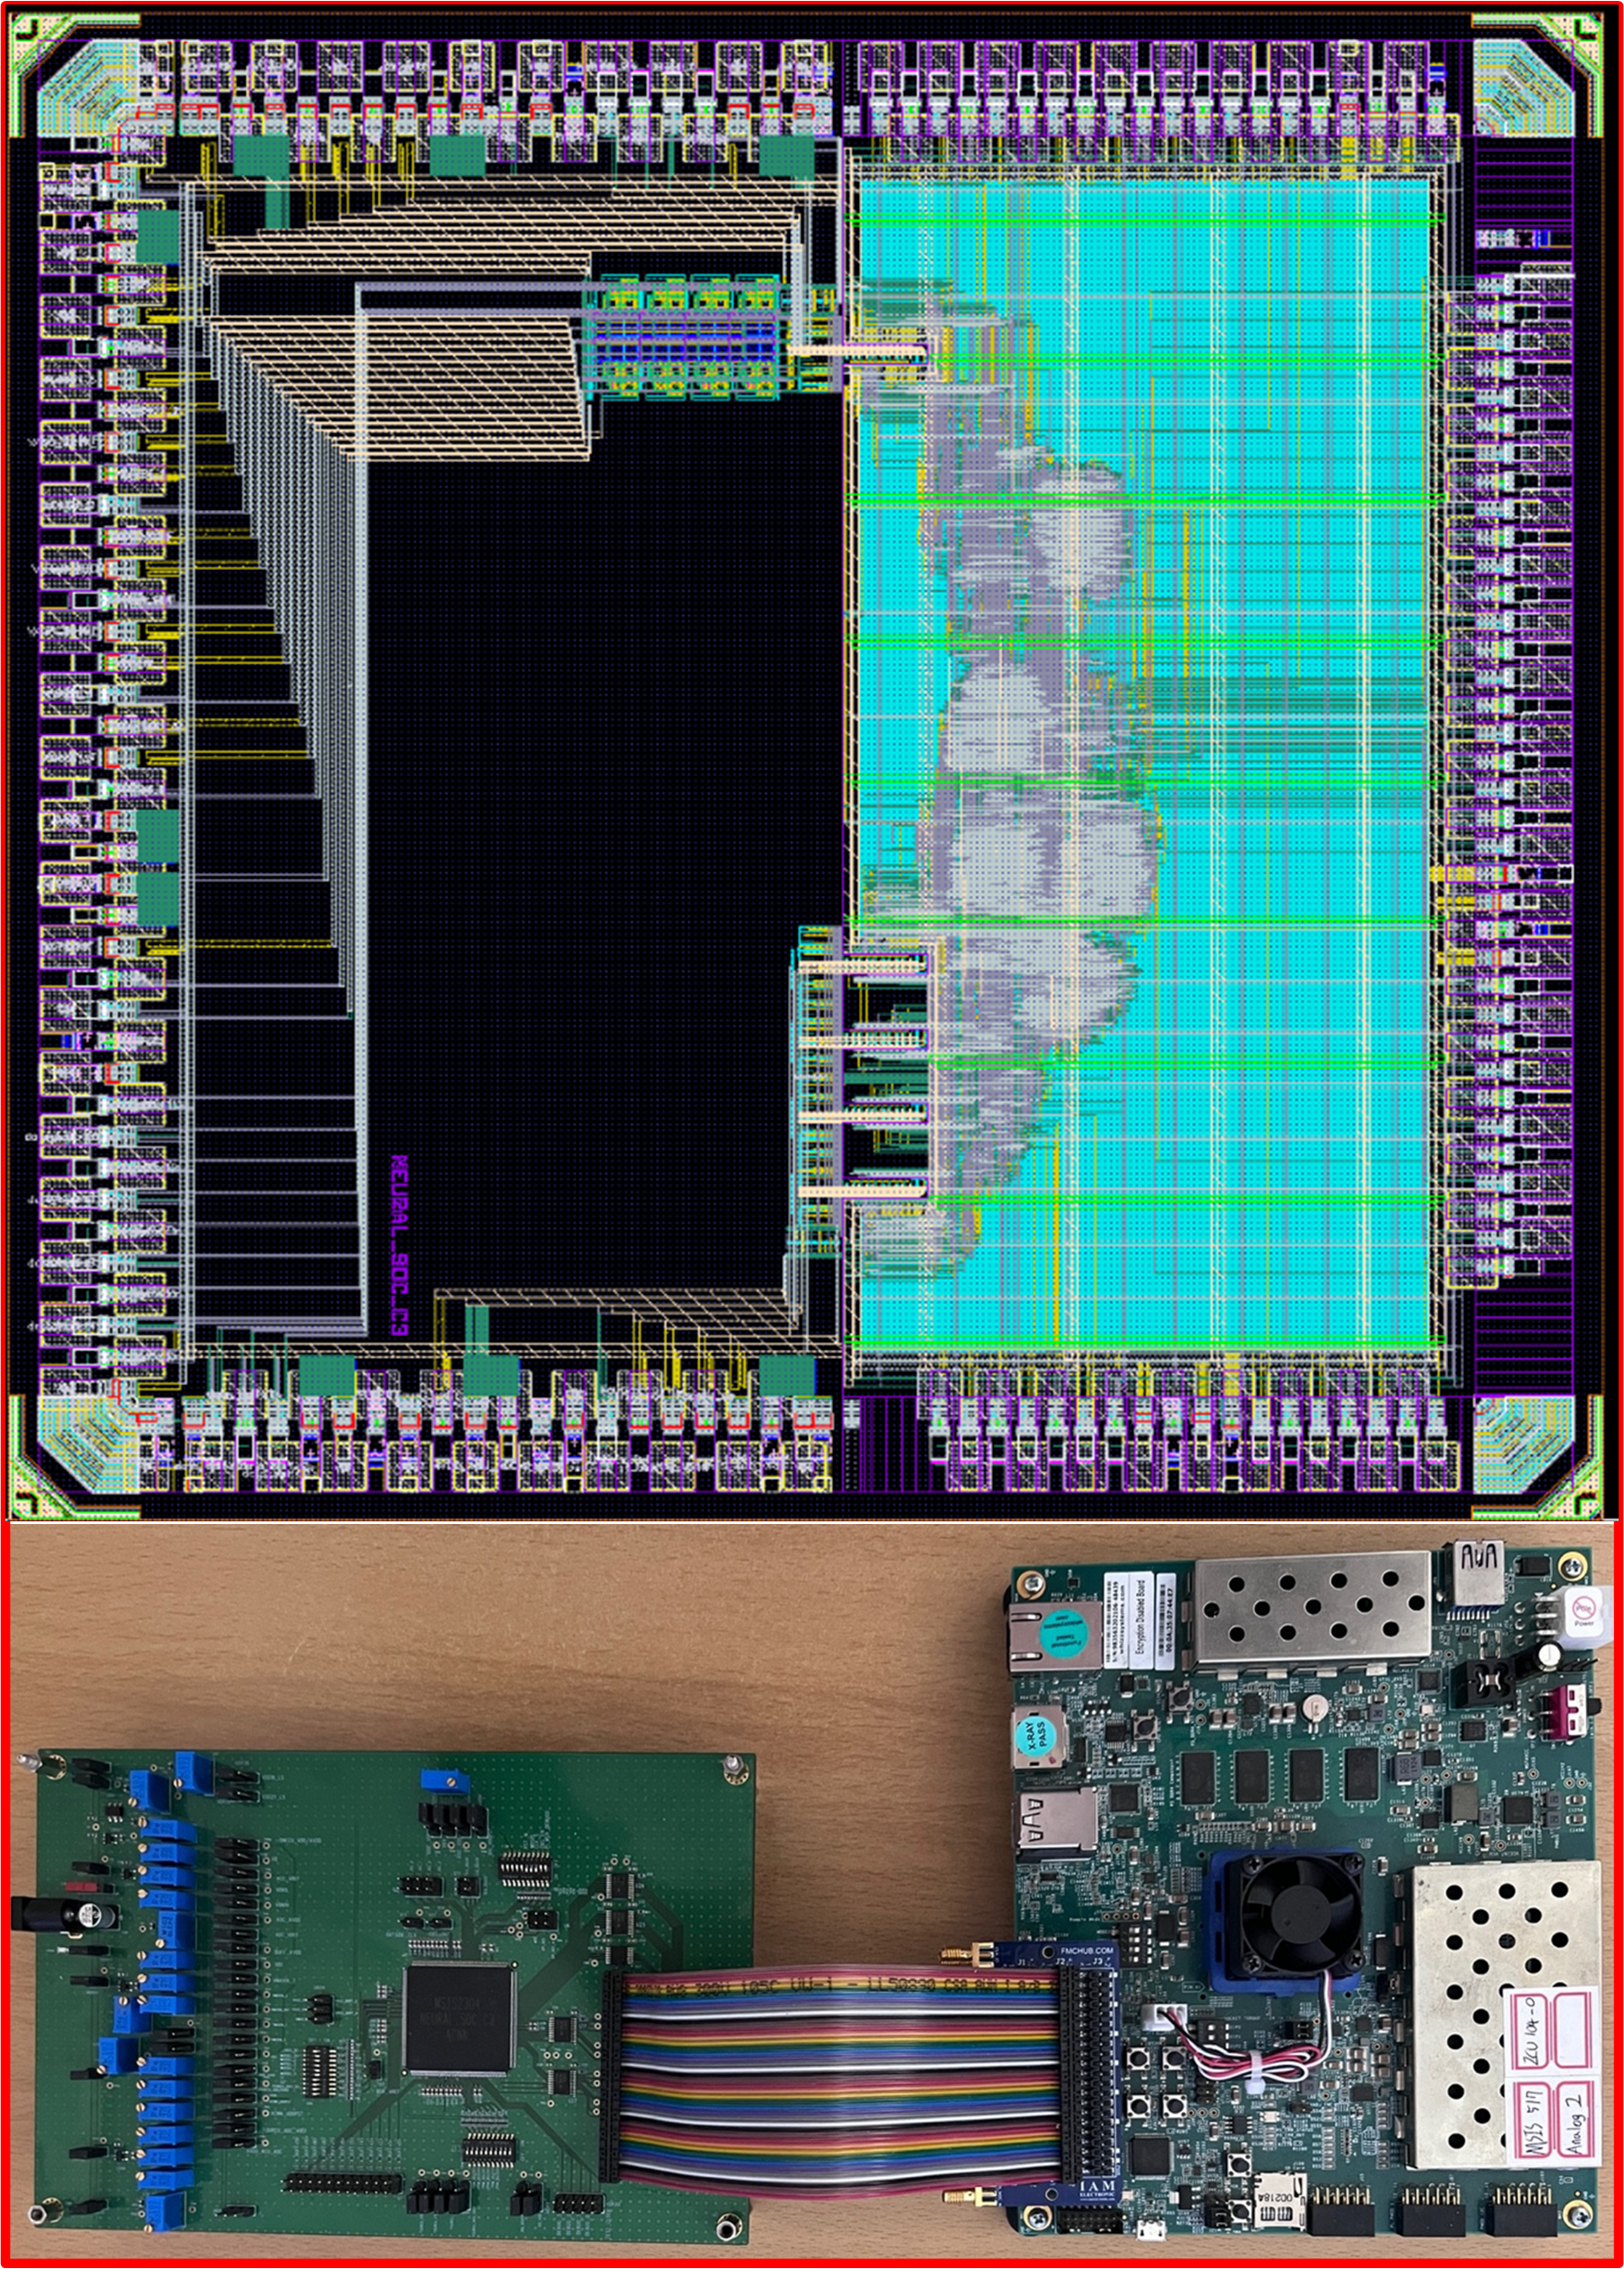
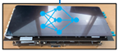
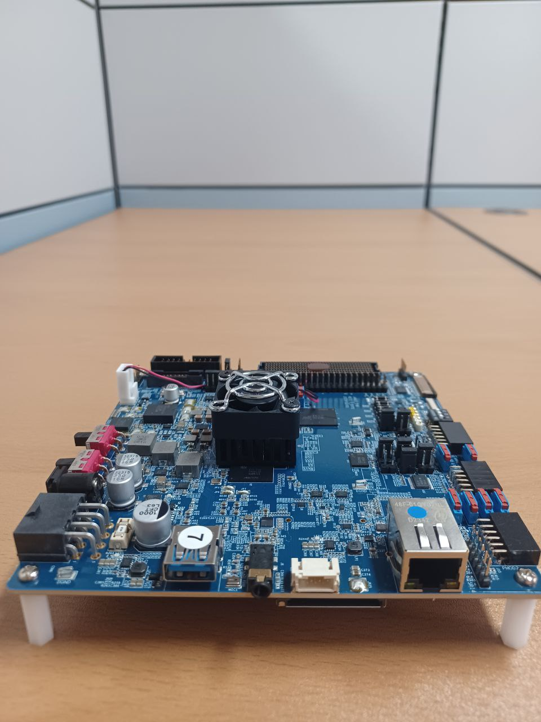
Project Participation & Contributions
NPUv2 (2022 – 2023)
High-Speed NPU Interface (AXI-Lite/Full)
5x5 Pooling Block
Top Integration
System-C verification
Chip Verification
ACNN (2023)
Custom Parallel Interface
Single/Burst Mode
Digital Controller
Loading data once from off-chip memory
Re-use of on-chip memory data
Chip Verification
NPUv3 (2023 – 2024 ): Expected in June
Top Level Integration
System-C simulation
Chip Verification Preparation:
NFS/Pytorch capable Embedded Linux
D4 Board
Expected Chip with Board

Slide 46
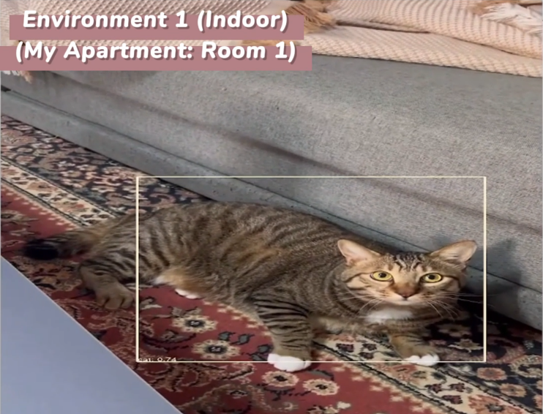
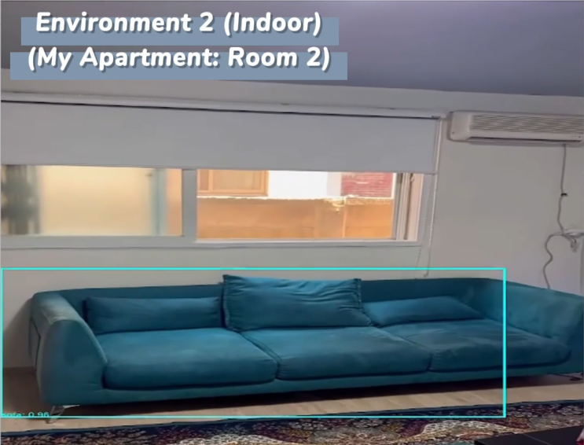




Prof. SeokCheol Kee (기석철 교수님)
Demo: 3 Indoor, 3 Outdoor and 1 Semi-Indoor/Outdoor Environment
10 out of 20 Objects (Different Sizes): Cat, Potted Plant, Bicycle, Bottle, Car, Motorbike, Sofa, Monitor, Chair, Person
Other Classes: Boat, Plane, Cow, Train, Dog, Bus, Dining Table, Horse, Sheep, Bird

Slide 47
Prof. Yuseok Ban (반유석 교수님)
Question – Page 45: Is there any ablation studies?
Can we see the contribution of certain sub-sections
Layer-wise Energy consumption
Accuracy Reduction after each optimization step

Slide 48


Question & Answers

